Slide 1
Feature-Aligned T-Meshes
Ashish Myles†
Nico Pietroni*
Denis Kovacs†
Denis Zorin†
† New York University
* ISTI, Italian National Research Council

Slide 2
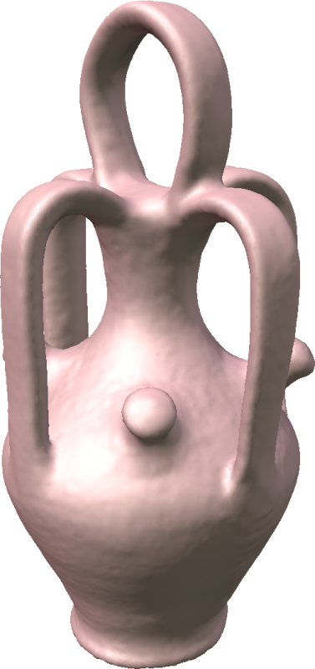
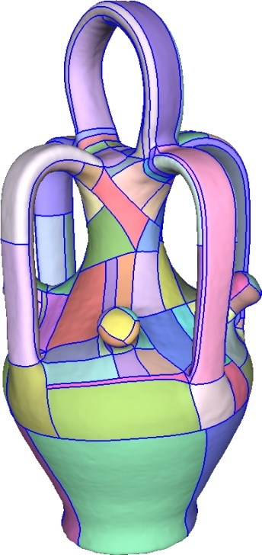
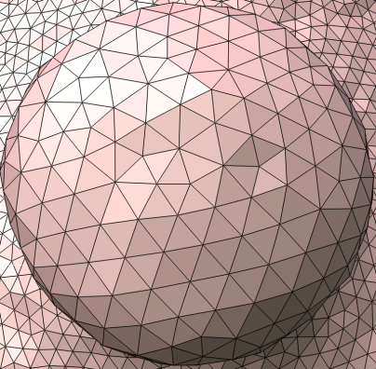
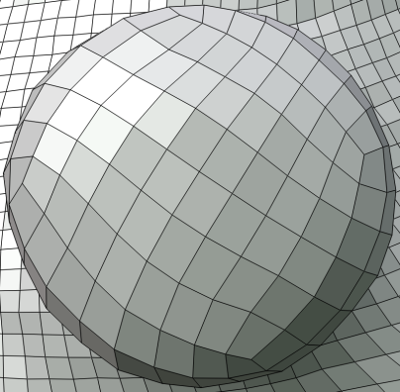
Motivation
Problem 1: Convert arbitrary meshes to collections of rectangular geometry images
  Multiresolution structure
  Compact storage:
  almost no connectivity
  GPU and cache-friendly:
  large speedups
  Adapt image-processing
  algorithms

Slide 3
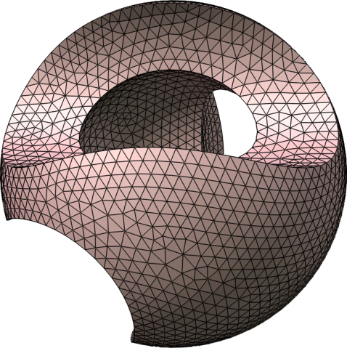
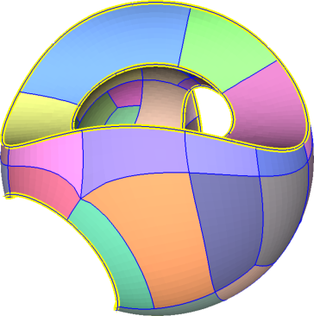
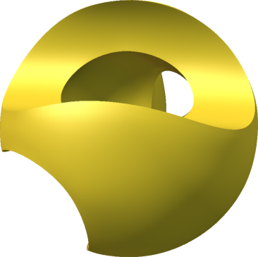
Motivation
mesh
patches
spline
Problem 2: Convert arbitrary meshes to high-order patches (splines, subdivision surfaces…)
  very compact representation
  for p.w. smooth surfaces
  reverse engineering
  base surface for displacement maps

Slide 4
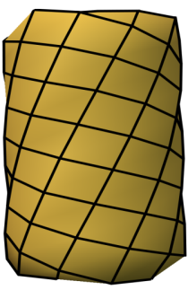
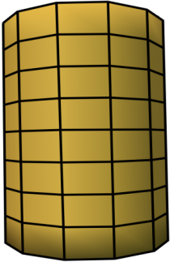
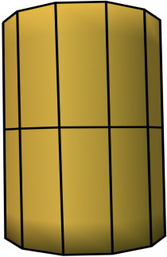
Geometry images
Goals:
  As few patches as possible
  Quads aligned with curvature directions/features
  No extreme aspect ratios
unaligned
aligned
aligned
stretched

Slide 5
Related work
Harmonic, Conformal (smooth uniform patches)
Levy, Petitjean, Ray, Maillot. “Least Squares Conformal Maps”
Tong, Alliez, Cohen-Steiner, Desbrun. “Quadrangulations with discrete harmonic forms”
Dong, Bremer, Garland, Pascucci, Hart. “Spectral Surface Quadrangulation”
Springborn, Schröder, Pinkall. “Conformal equivalence of triangle meshes”
Feature-aligned (patches aligned to cross-field on the surface)
Ray, Li, Levy, Scheffer, Alliez. “Periodic global parametrization”
Kälberer, Nieser, Polthier. “QuadCover”
Bommes, Zimmer, Kobbelt. “Mixed Integer Quadrangulation”
Zhang, Huang, Liu, Bao. “A Wave-based Anisotropic Quadrangulation Method”
Simplification-based (local simplification, generate large patches)
Shepherd, Dewey, Woodbury, Benzley, Staten, Owen.
“Adaptive mesh coarsening for quadrilateral and hexahedral meshes”
Staten, Benzley, Scott. “A methodology for quadrilateral finite element mesh coarsening”
Daniels II, Silva, Cohen. “Semiregular quad-only remeshing”
Tarini, Pietroni, Cignoni, Panozzo, Puppo. “Practical quad mesh simplification”
Many more

Slide 6
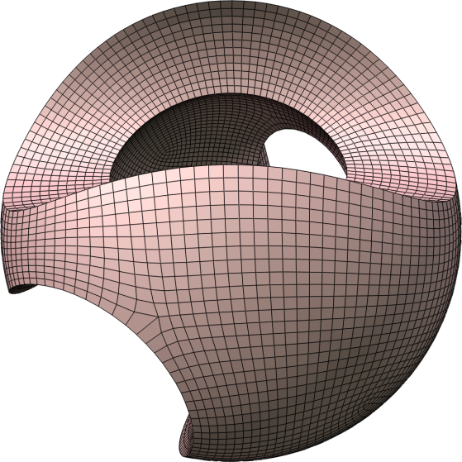
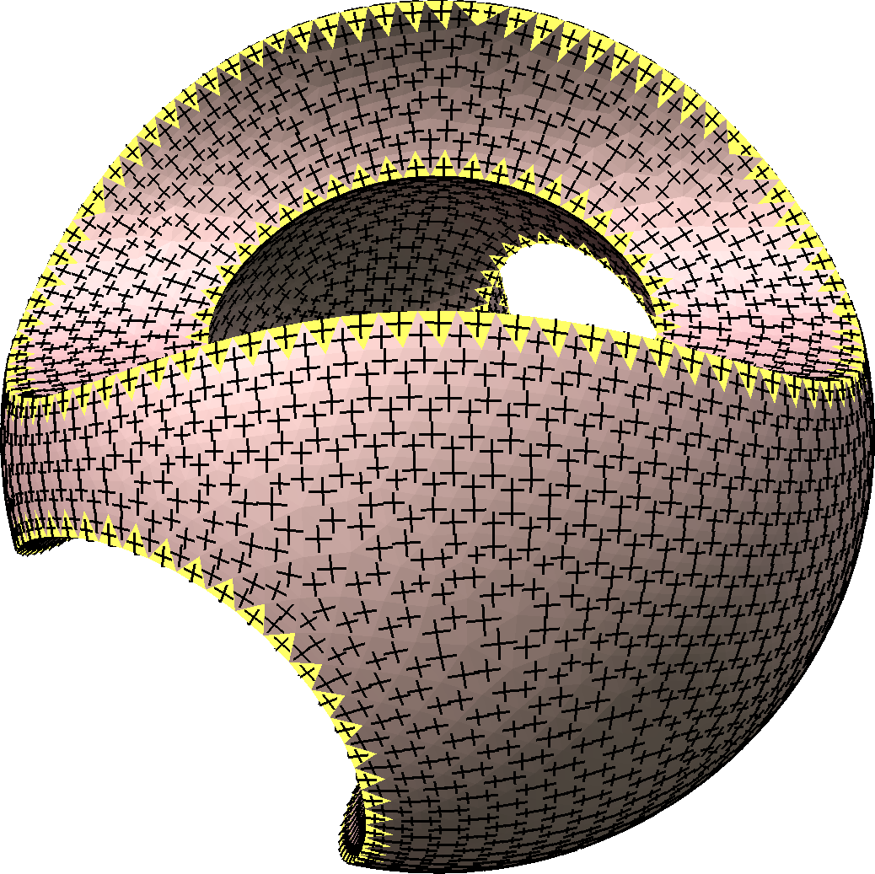
Feature alignment
Based on feature-aligned quadrangulation
  Crossfield for
  feature alignment
  Matches curvature directions where well-defined
  Smoothly interpolates directions in umbilical areas
  Generates few singularities in feature-aligned parametrization
crossfield
feature-aligned
quadrangulation

Slide 7
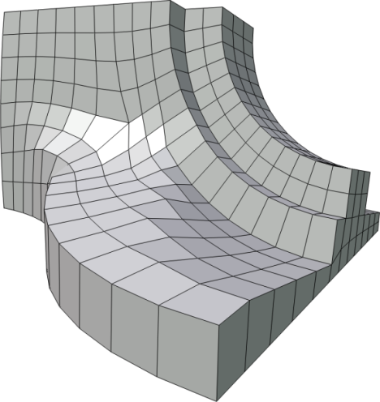
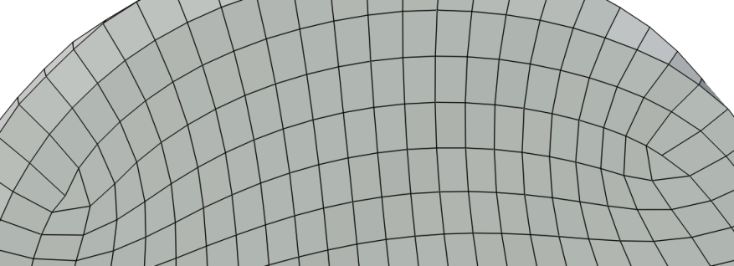
Coarse quadrangulations
Feature-aligned global optimization
Limitations
Patch size constrained by
Smallest distance between features
Slightly-mismatched singularities
⇒ long thin patch
Patch
singularities

Slide 8
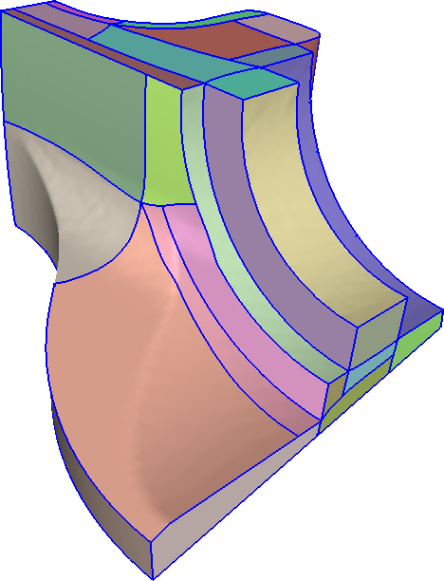
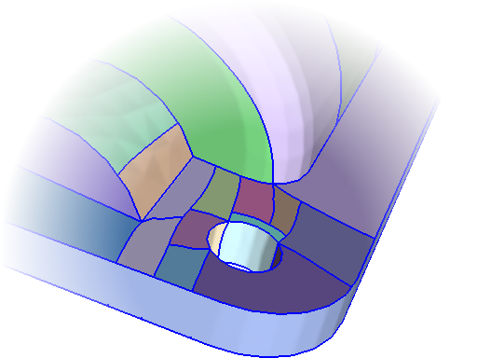
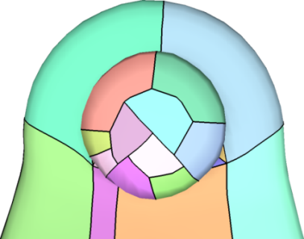
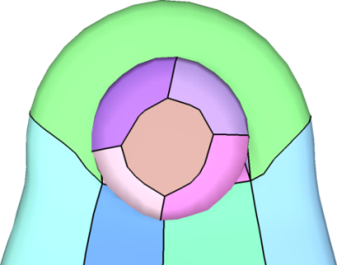
Remove these restrictions
T-meshes
Quad mesh with T-joints
  Feature alignment + few patches
  Isolate small features
Method
  Parametrization to
  T-mesh layout
  Adapt parametrization

Slide 9
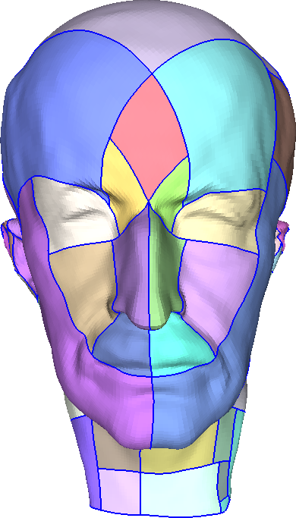
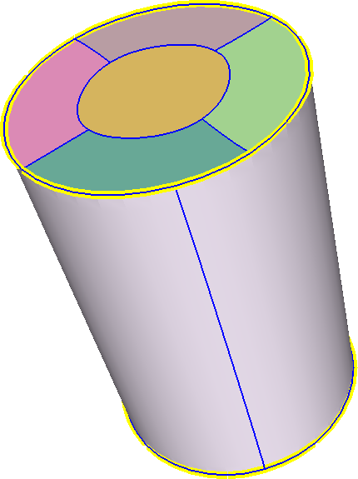
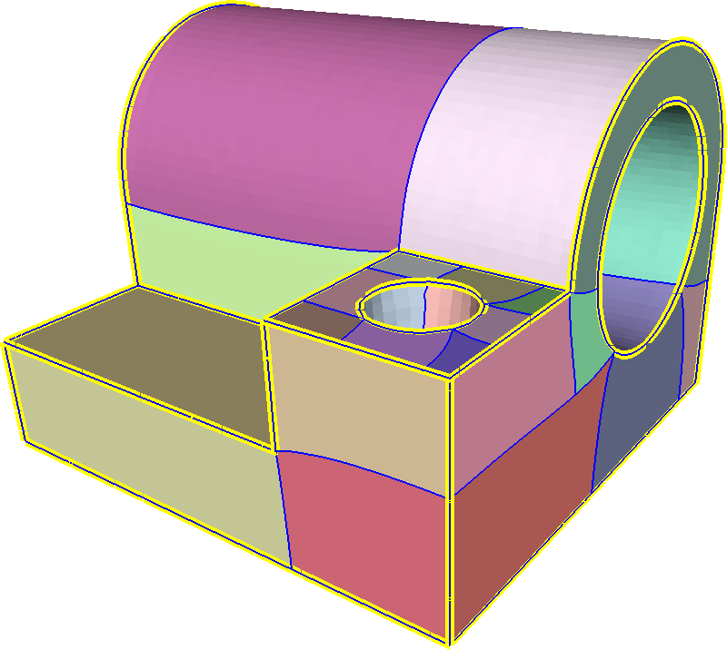
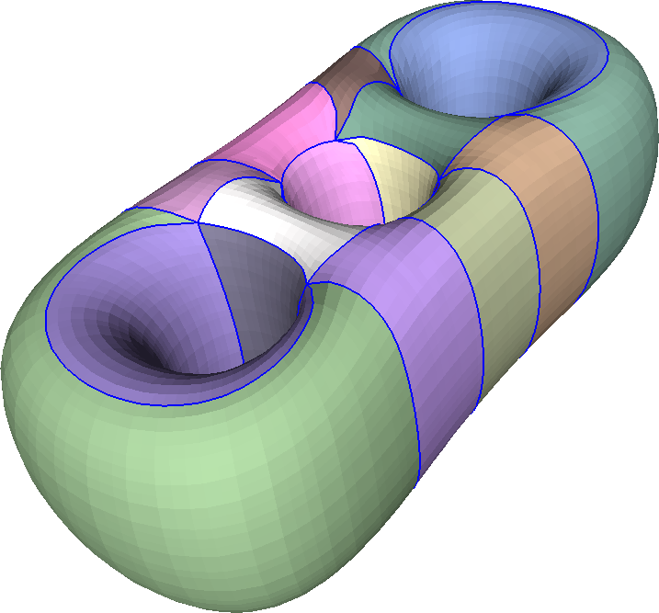
Goals
Recall
  As few patches as possible
  Quads aligned with curvature directions/features
  No extreme aspect ratios

Slide 10
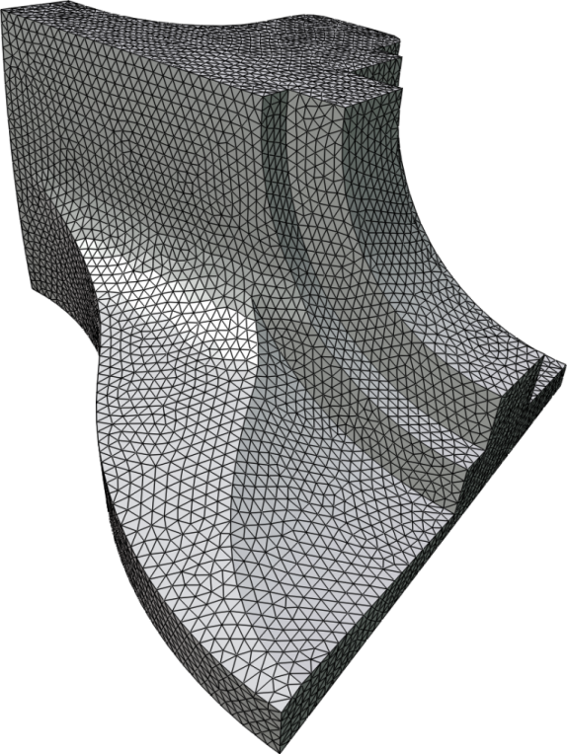
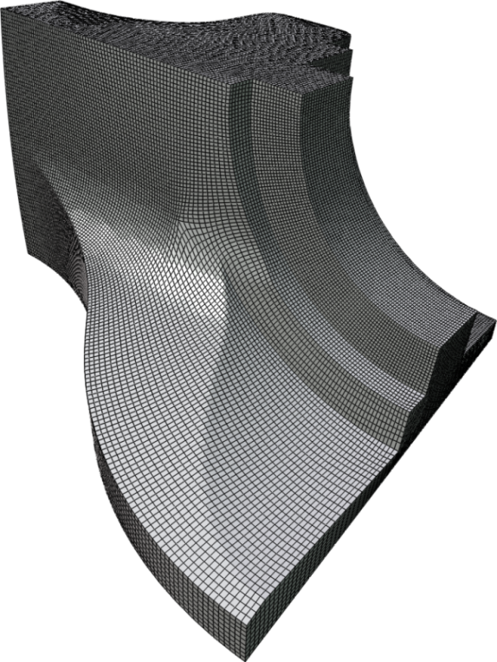
T-mesh generation
singularity
valence 5
pseudo-
Voronoi
cell
Parametrize
Generate
T-mesh
Input triangle mesh
Feature-aligned
parameterization
T-mesh
Singularities → patch corners
Singularity valence = # adjacent patches
Use this inherent structure to initialize T-mesh layout fast
  Grow pseudo-voronoi cells from singularities

Slide 11
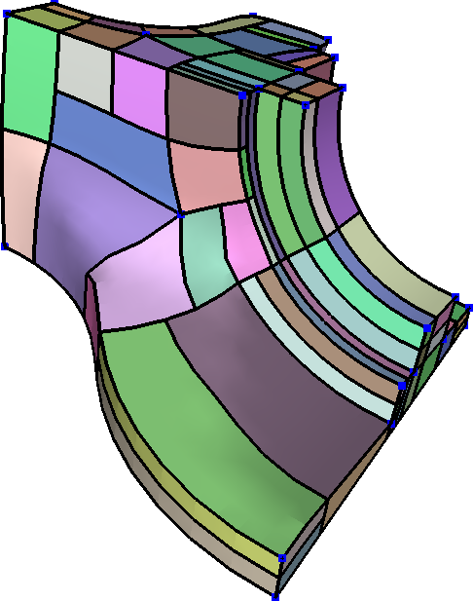
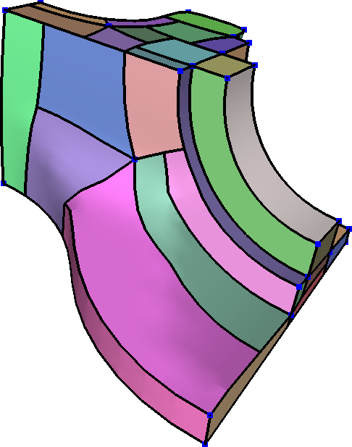
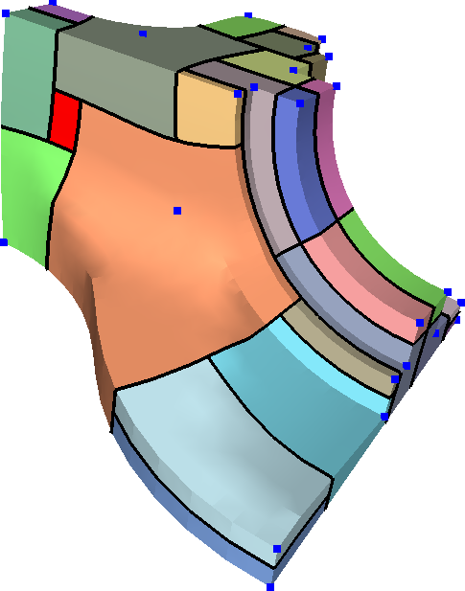
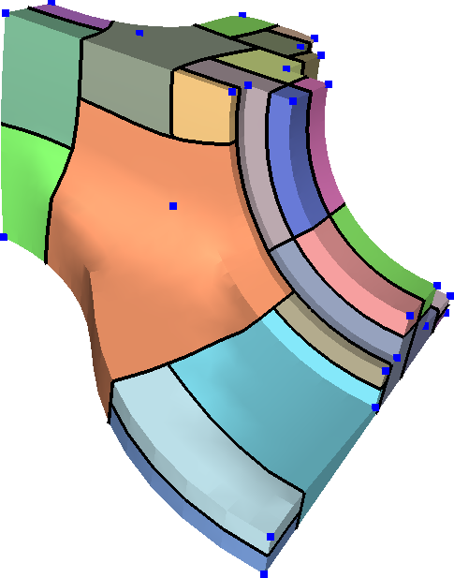
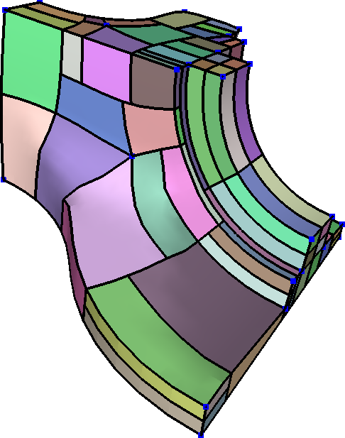
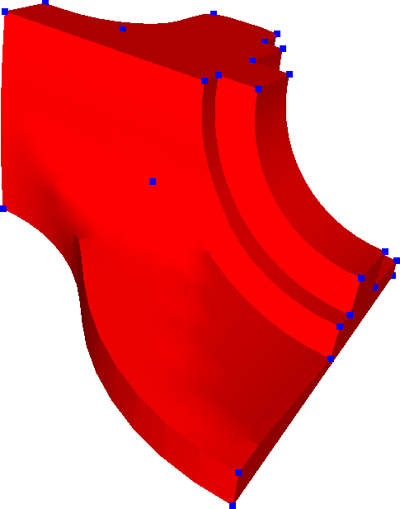
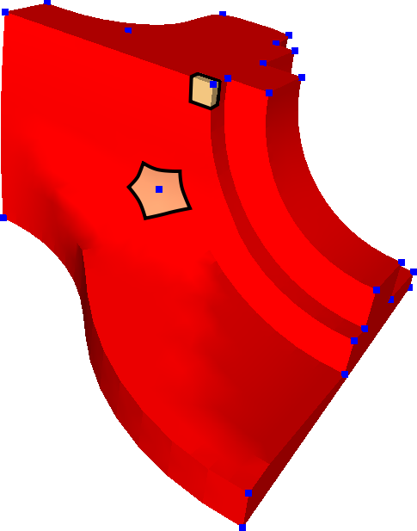
T-mesh layout
Start with feature-aligned parametrization
Singularity cell expansion
Remove holes
  Adjust boundaries
  Introduce patches if needed
Split into quads
Reduce number of T-joints
  Adjust boundaries
Greedy optimization of layout
  With user-specified criteria
holes
removable
T-joints

Slide 12
T-mesh greedy optimization
Layout modification operators
Greedy minimization
Energy:
  Favors growth of small patches,
  less so for large
  Discourages thin patches
Optional constraints:
Limit patch aspect ratios
Bézier error (local cubic approx)
refinement
extension
relocation

Slide 13
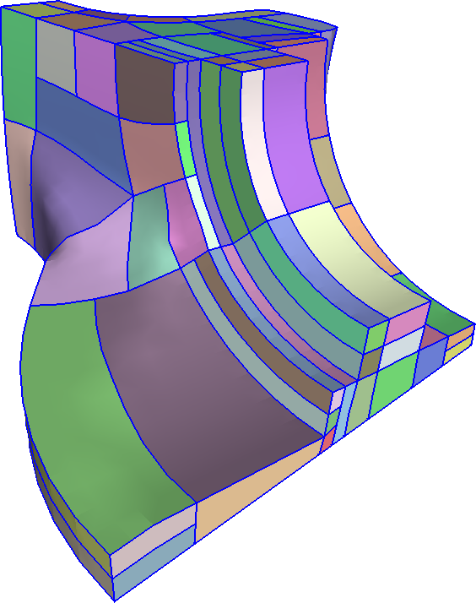
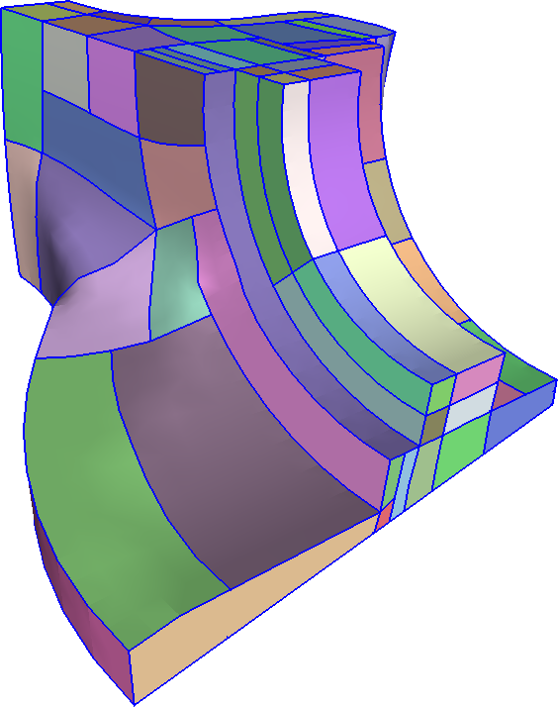
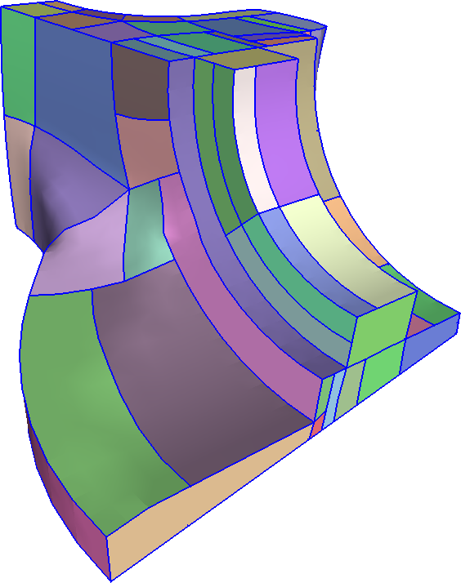

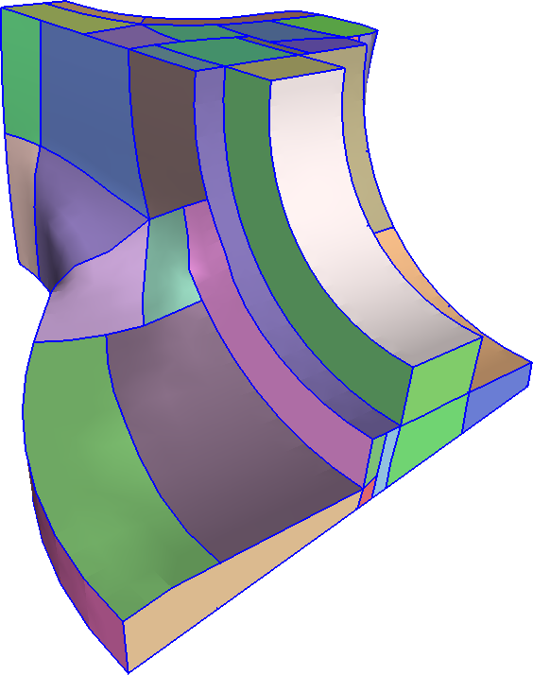
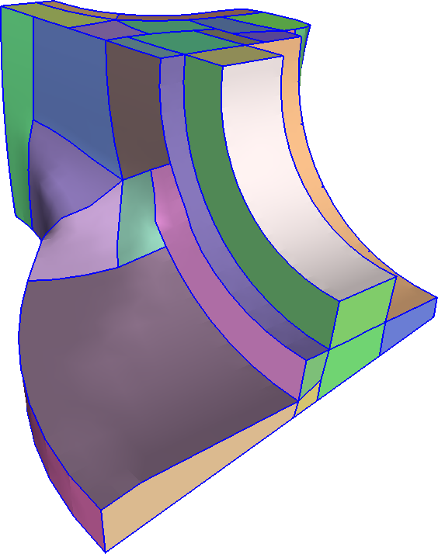
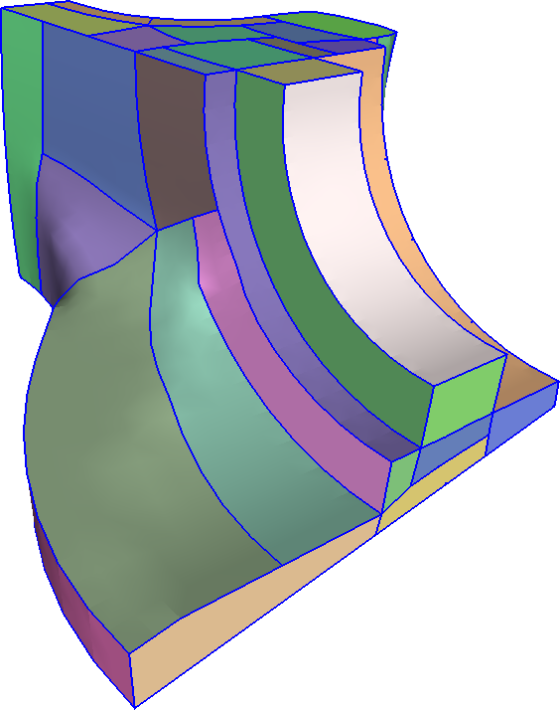
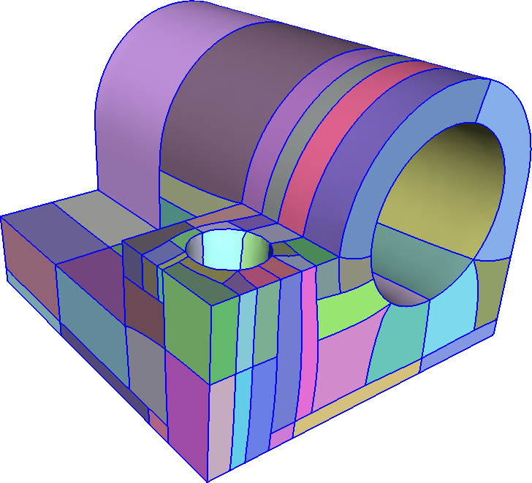
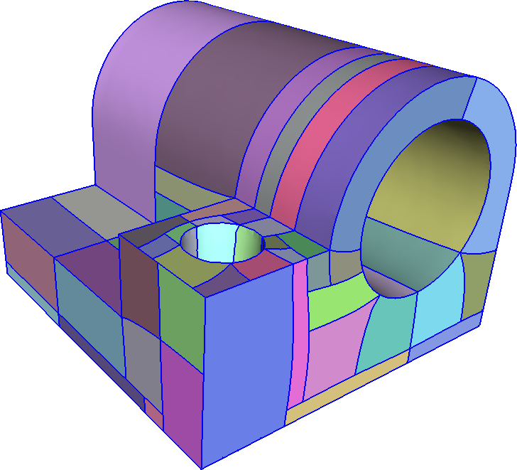
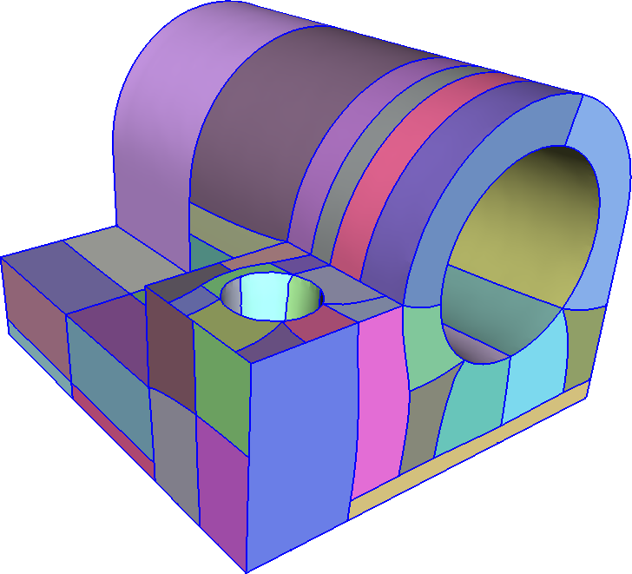
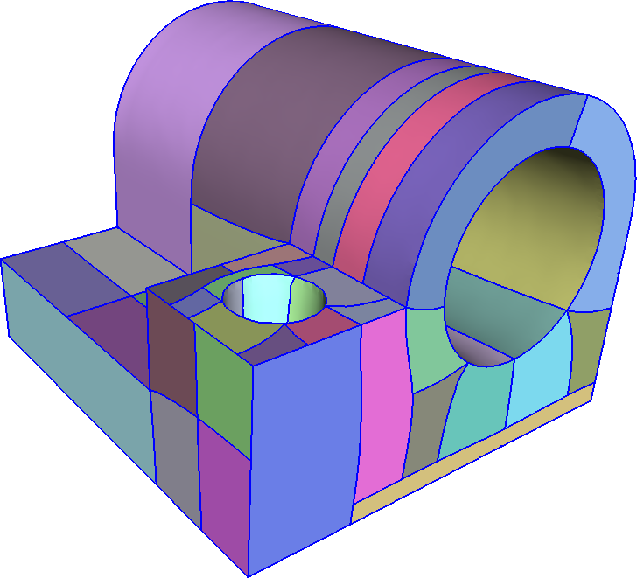
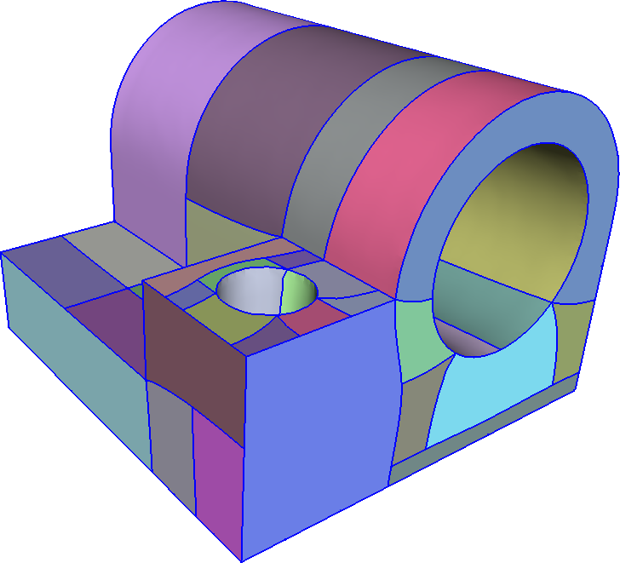
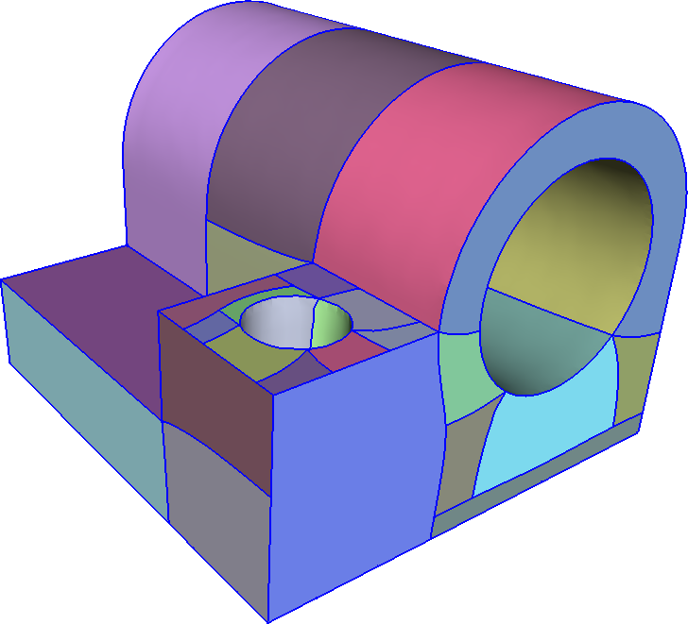
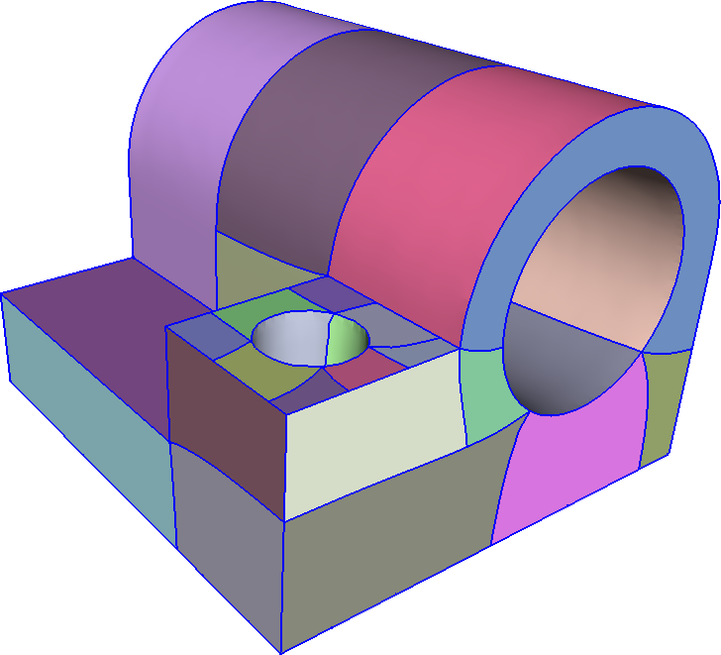
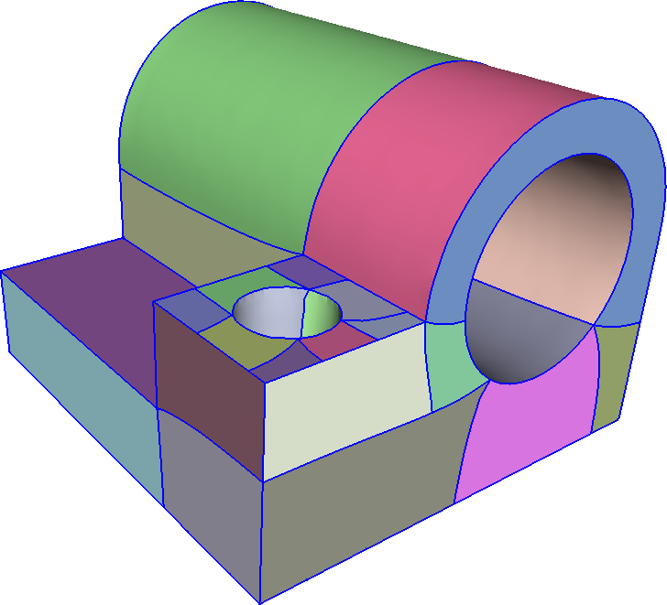
T-mesh optimization results

Slide 14
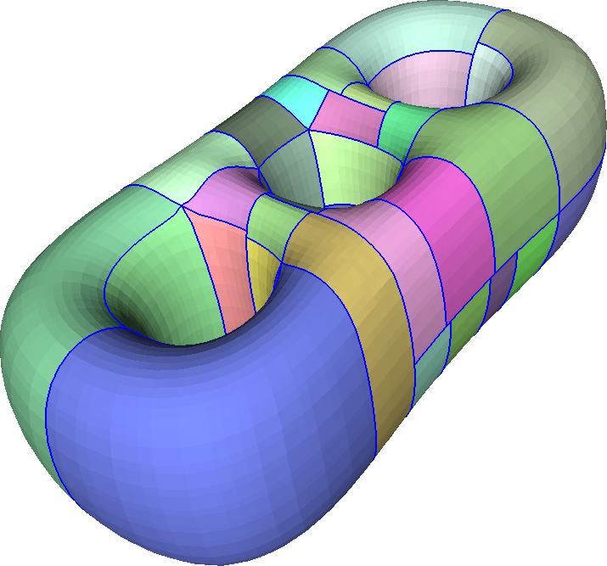

T-mesh optimization
Significant decrease in energy
But still too many
T-joints

Slide 15
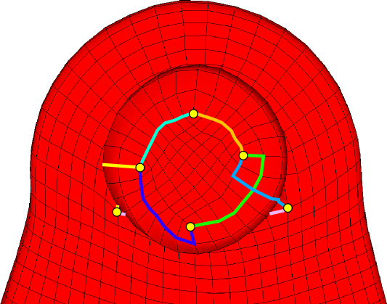
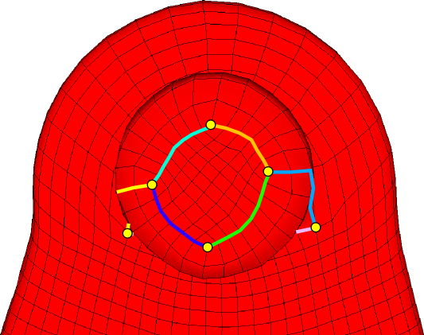

Improve parametrization
Slightly misaligned singularities away from features
⇒ removable T-joints
Align singularities:
  Parametrize
  Identify misaligned pairs
  Constrain coordinates
  Parametrize again with
  constraints
How to generate these constraints?

Slide 16
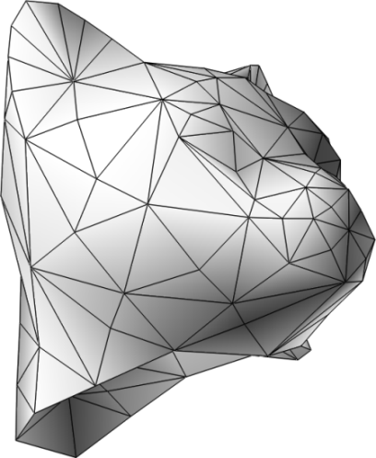
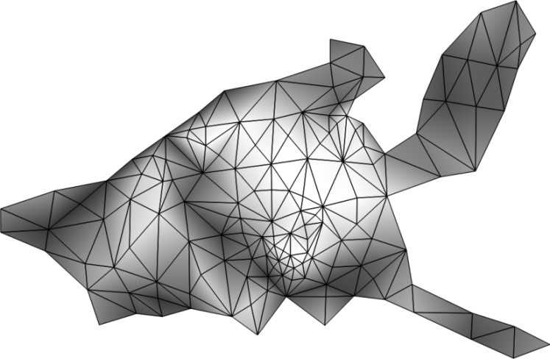


Global parametization details
v
u
singularities
misalignment
  Singularities: quadrangulation vertices with valence ≠ 4
  Misalignment: singularities on close parametric lines

Slide 17


Alignment constraint
  Singularity alignment: make u or v the same
  Mesh is cut for parmetrization
  ⇒ generating constraint much more complex,
  but idea is the same
(u₁, v₁)
v
(u₁, v₁)
(u₂, v₂)
cut
cut
jump
u
introduce constraint: v₁ = v₂
mismatch
(u₂, v₂)

Slide 18



Results
Singularity alignment

Slide 19







Results
Few, large patches
10x – 100x fewer with T-joints

Slide 20


Results
Bézier error optimization for T-spline fit

Slide 21



Summary
T-meshes
Quad layouts with T-joints
Technique
  Builds on top of existing parametrization algorithms
  Few, large feature-aligned patches
  Constrain error, patch aspect ratio
Supported by
  NSF awards IIS-0905502, DMS-0602235
  EG 7FP IP "3D-COFORM project
  (2008-2012, n. 231809)"

Slide 22
Thank you

Slide 23
Backup slides

Slide 24


Limitations
Scalability (large models)
  Generate field (bottle neck)
  Parametrize + quadrangulate
  Optimize T-mesh
Robustness of parametrization
(regularity)
v
u

Slide 25


Limitations
Sharp edge and singularity alignment constraints can interact with global system in unpredictable ways
Screw example:
circular sharp edge interacting with
helical sharp edge
  Needs a pair of singularities
without
additional
singularities
v
v
u
u

