Slide 1
Global Parametrization by Incremental Flattening
Ashish Myles
Denis Zorin
New York University

Slide 2
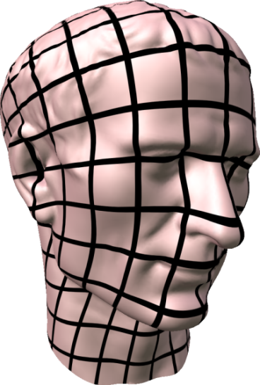
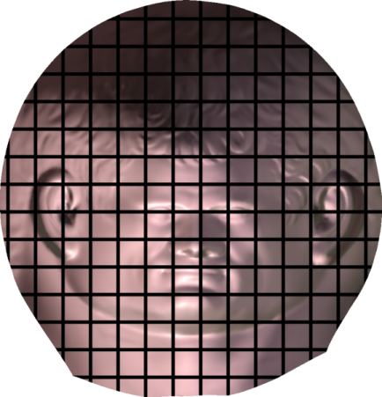
Parametrization
Flatten a surface to a plane
Texture mapping
Geometry images
Quadrangulation

Slide 3
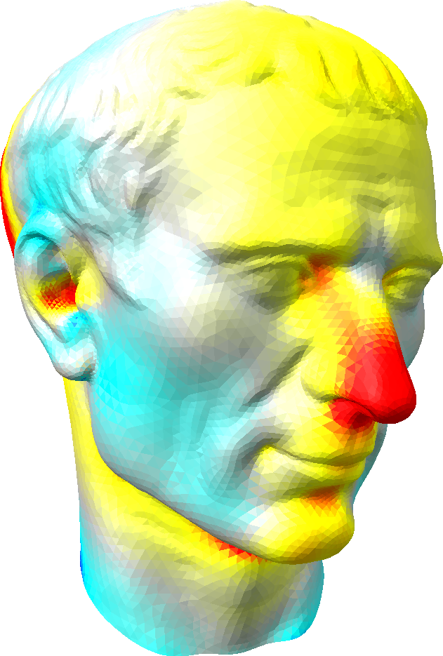
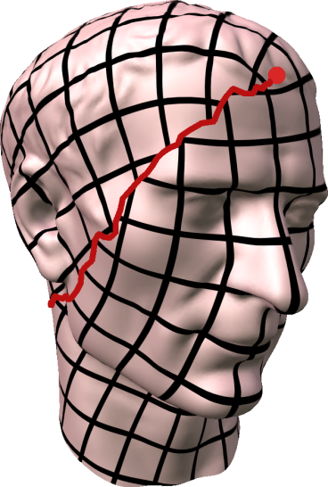
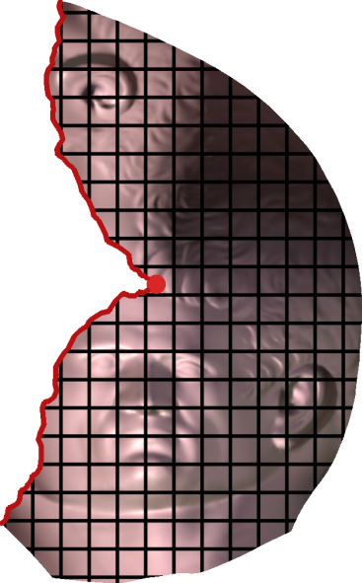
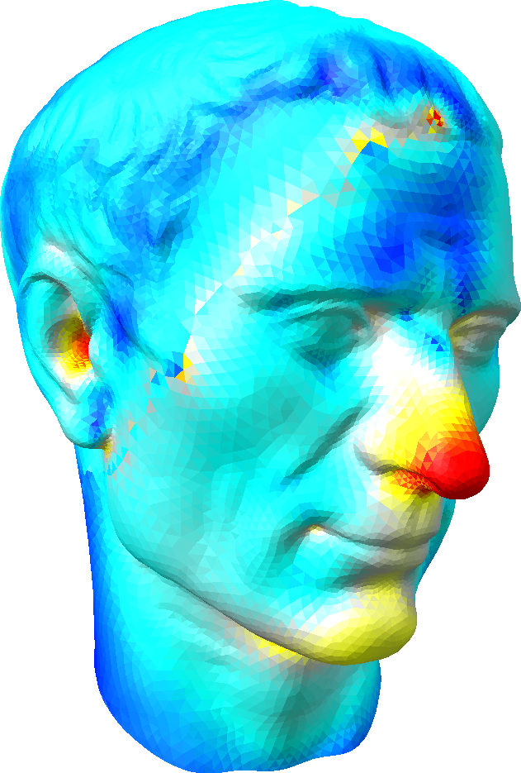
Parametrizations with cuts
Surface
Parametrization
Distortion
Bad for
quadrangulation
seamless texture mapping
discontinuous grid lines

Slide 4
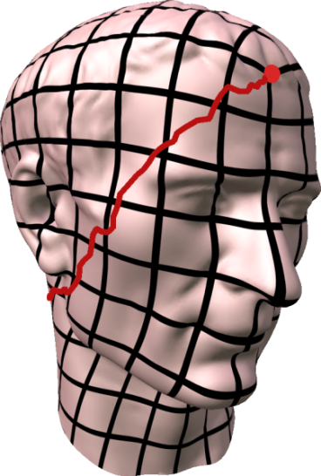
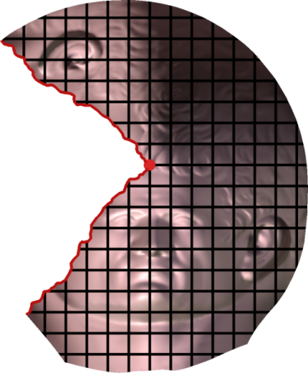
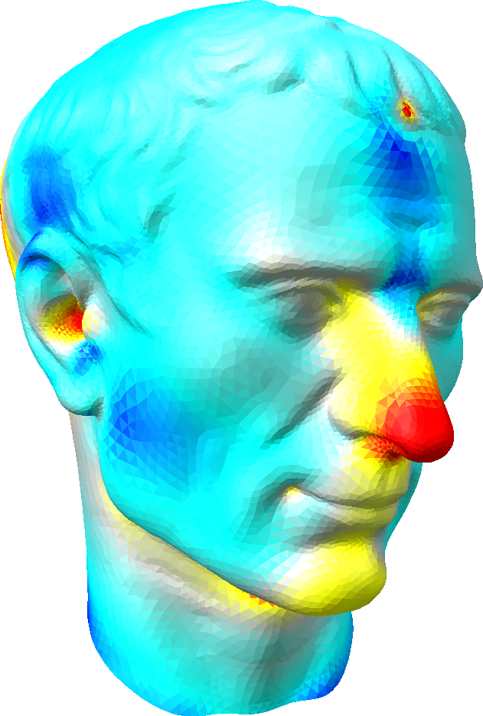
Parametrizations with cuts
Surface
Parametrization
Distortion
π/2
discontinuous grid lines
continuous grid lines
Seamless parametrization

Slide 5
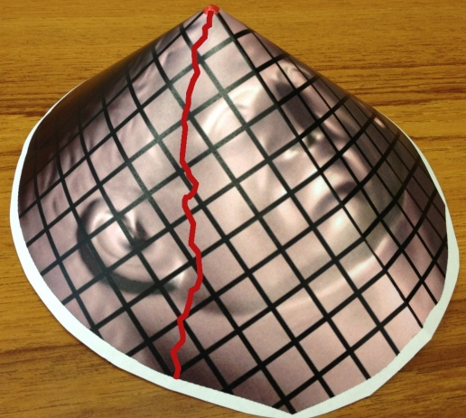
Seamless parametrization
cone singularity
(quad valence 3)
integrated curvature π/2 (angle deficit)
π/2
≡
physical cone
zero curvature
Seamless parametrization:
mostly flat (zero curvature almost everywhere)
rounded cone curvatures (multiple of π/2 at cones)

Slide 6
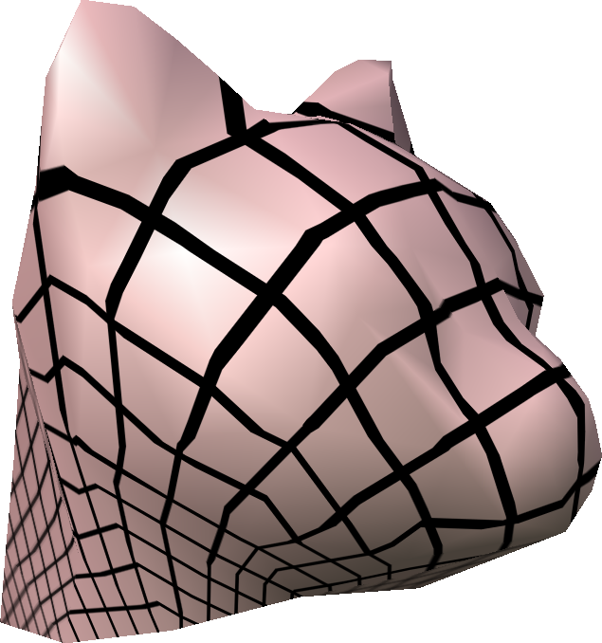
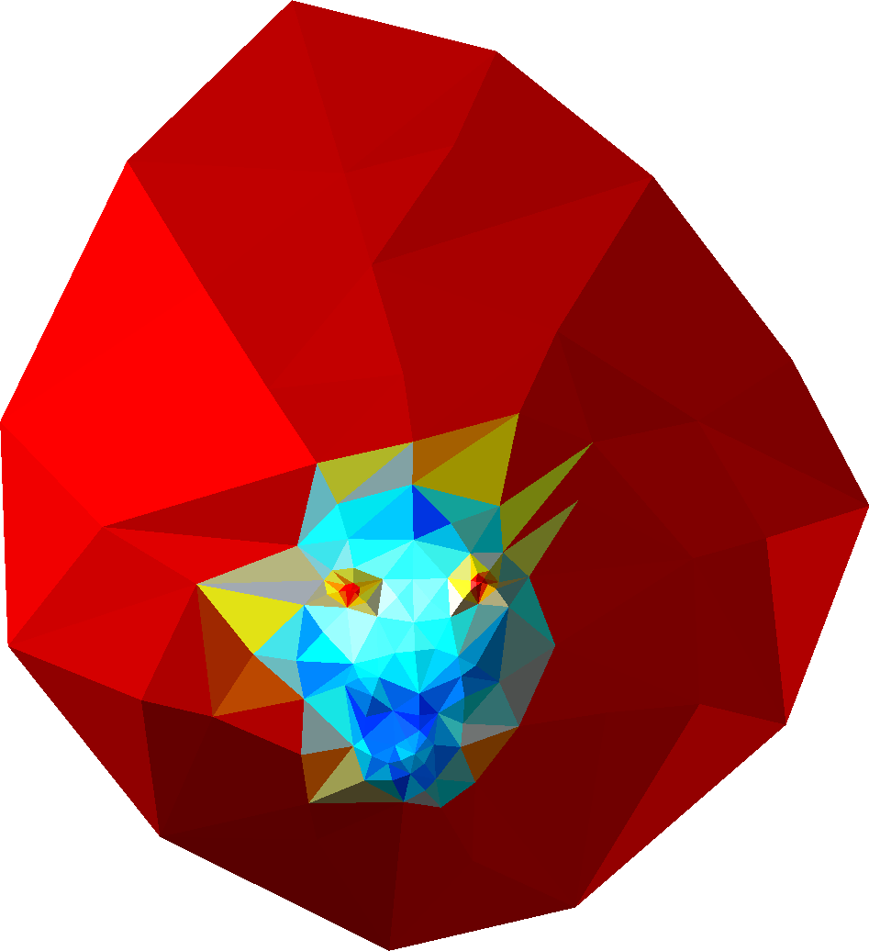
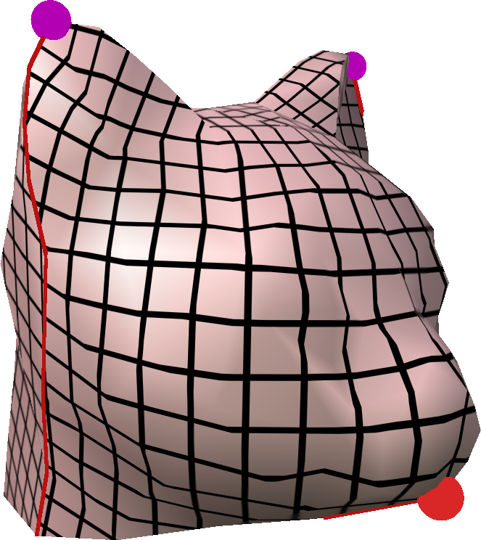
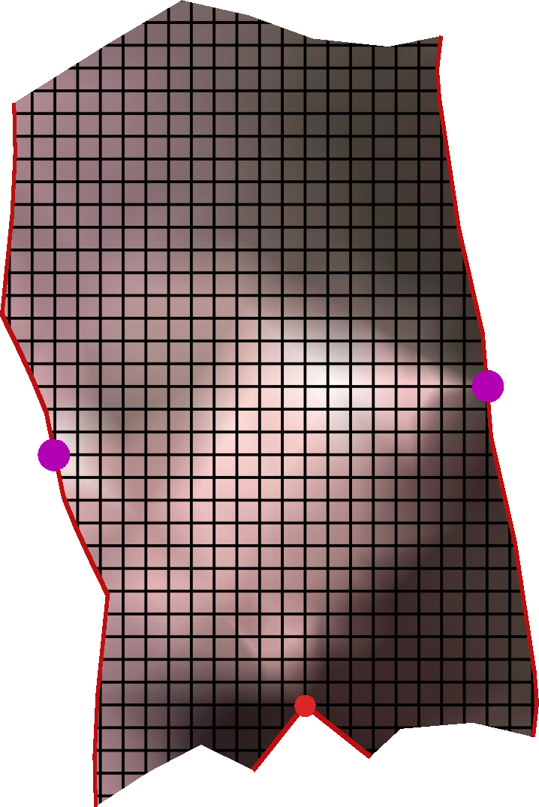
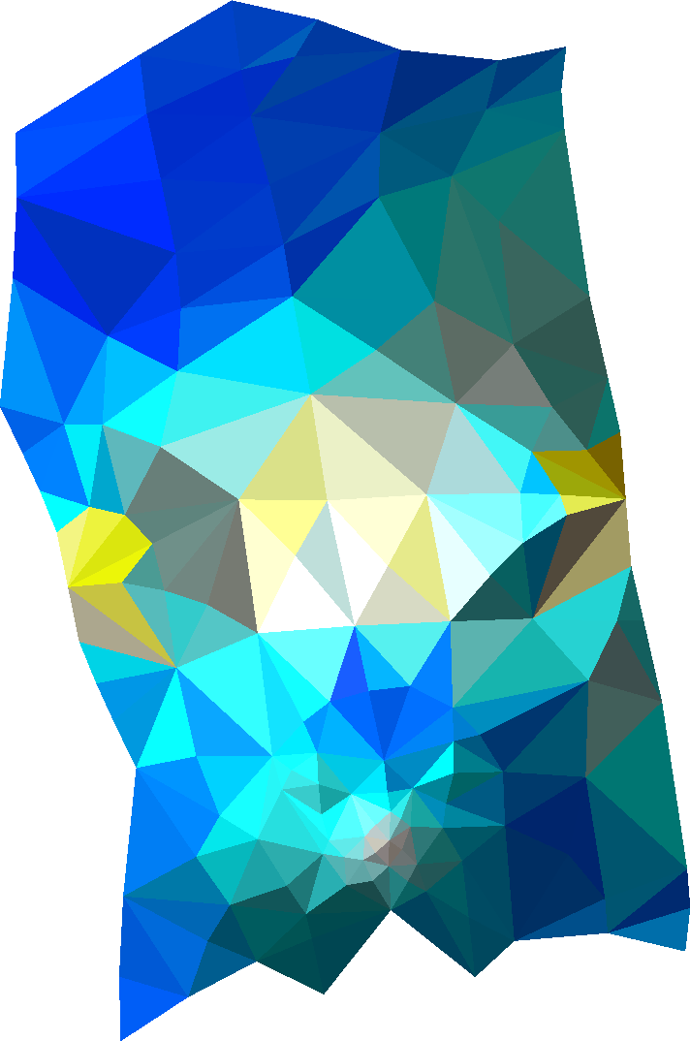
Cones help reduce distortion
Curvature π (angle deficit)
π
π
Curvature π/2 (angle deficit)
π/2

Slide 7
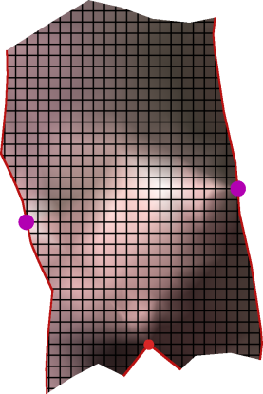
Goal
Automatically determine cone locations + curvatures to minimize surface distortion
No cones High distortion Bad
3 cones Low distortion Good

Slide 8
Idea: gradually evolve curvature
gradually evolve
Flat surface, cones with rounded curvature
Input surface, arbitrary curvature
Gradual evolution ⇒ good distortion control
No parametrization until evolution is complete!

Slide 9
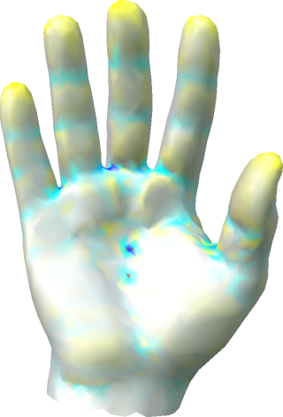
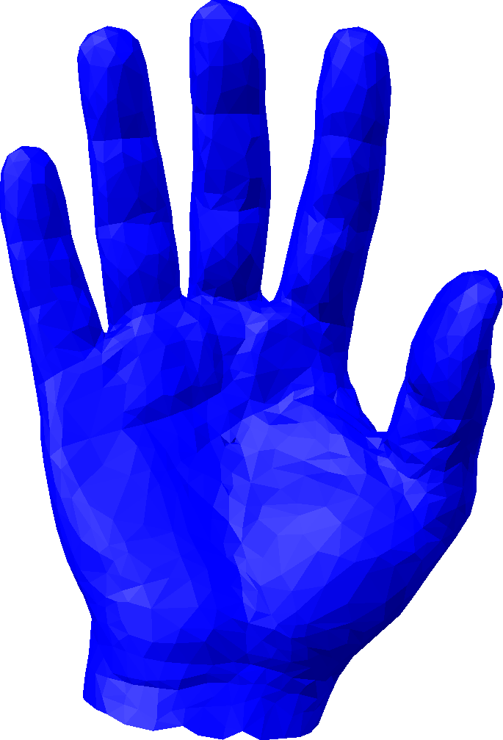
Flattening + curvature concentration
Gaussian curvature
distortion

Slide 10
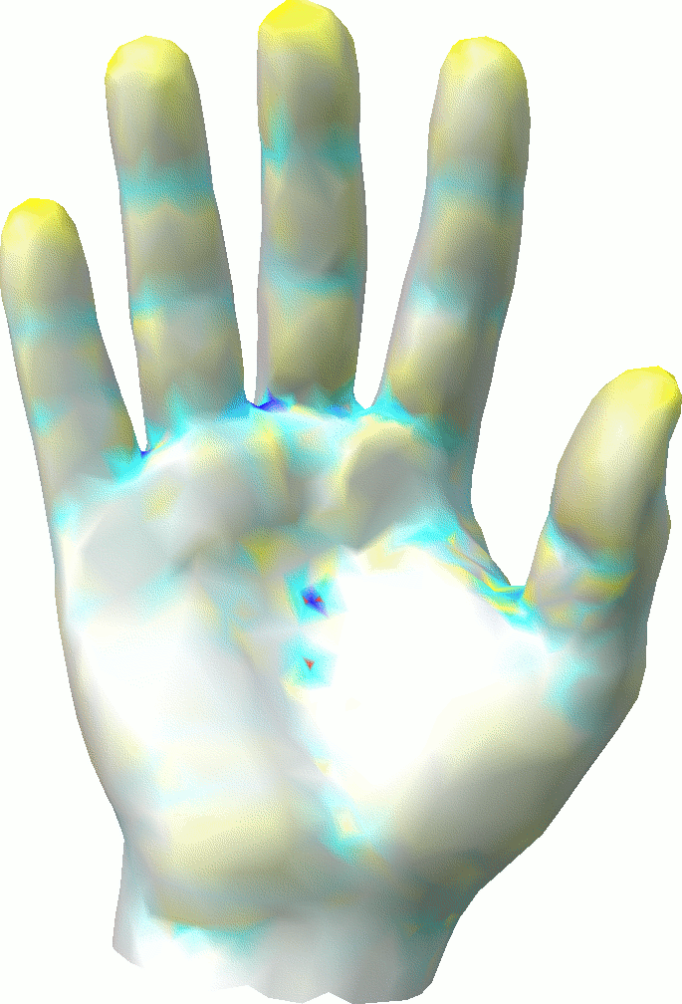
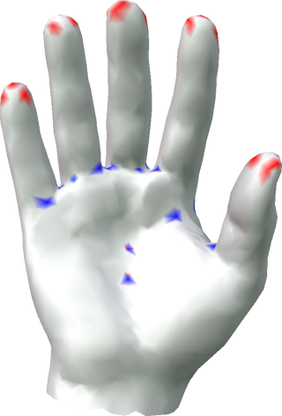
Flattening + curvature concentration
Flattening + curvature concentration

Slide 11
Flattening + curvature concentration
Flattening algorithm
Repeat until (curvature concentrated)
Flatten all points with curvature within ε
Redistribute curvature to unconstrained points minimizing distortion
Increment ε
Gaussian curvature
distortion

Slide 12
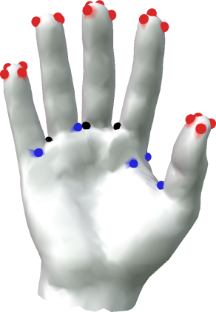
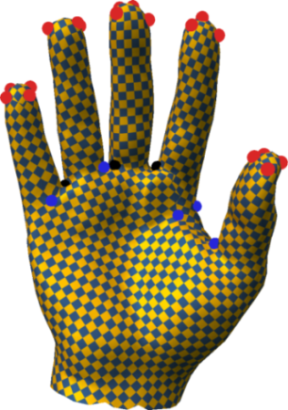
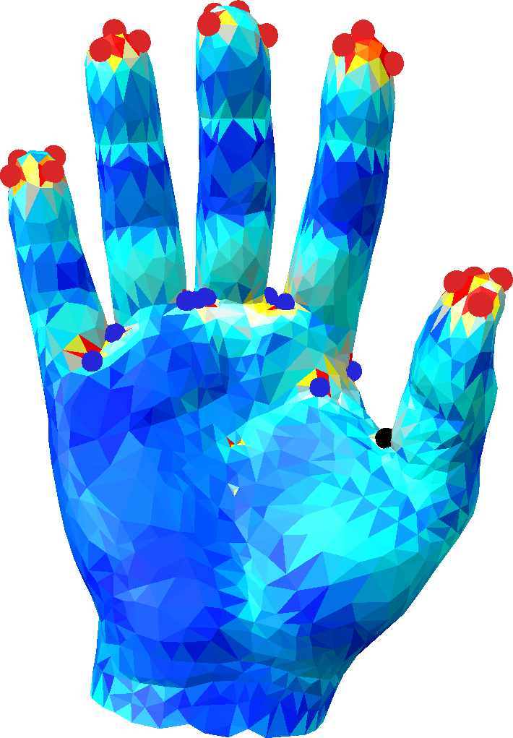
Rounding + parametrization
Rounding algorithm
Repeat until (all curvature rounded)
Round curvature closest to multiple of π/2
Redistribute curvature to unconstrained points minimizing distortion
Result: flat surface with rounded cones
Isolated curvatures
Rounded curvatures
Seamless parametrization
Distortion
curvature π/2
valence 3 cone
curvature –π/2
valence 5 cone

Slide 13
Questions
1. What is the distortion measure?
2. How to efficiently redistribute curvature to minimize distortion?

Slide 14
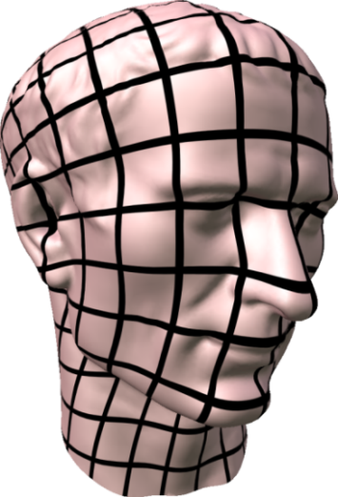
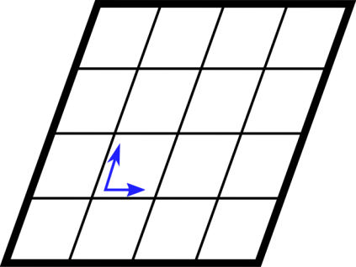
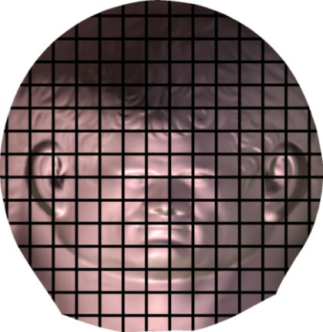
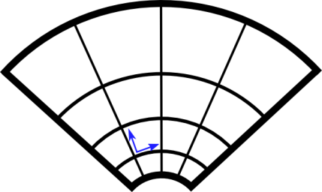
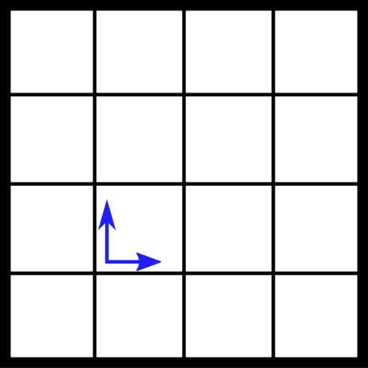
Parametrization types
f
Area-preserving
∇f
Conformal
(angle-preserving)
Input
Isometric
Goal

Slide 15
Distortion = isometry deviation
Want isometry
f
∇f = R
∇f
Use As-Rigid-As-Possible distortion [Liu 2008]
min_{R,f} ||∇f – R||² (R rotations, f param)
Highly non-linear relationship to curvature
Not good for curvature redistribution

Slide 16
ARAP in the conformal setting
Problem becomes linear!
locally scale by e^{ϕ}
ϕ ≡ log scaling factor ϕ = 0 ⇒ isometric
ARAP energy/distortion ≈ ∬ϕ²dA

Slide 17
ARAP in the conformal setting
K_{new} = π/2 (angle deficit)
Linear relation to curvature ∆ϕ = K_{new} – K_{orig}
Goal: Automatically determine
cone locations + curvatures (K_{new})
to minimize conformal ARAP distortion (∬ϕ²dA)
Simple, quadratic energy with
linear relationship to curvature!
ϕ
π/2
unknown
unknown
given
K_{orig}
K_{new} = 0 (flat)

Slide 18
Algorithm overview
Step 1. Flattening + curvature concentration
Repeat until (curvature concentrated)
Flatten all points with K_{new} within ε
Redistribute curvature
by minimizing distortion
∬ϕ² dA
constrained by
∆ϕ = K_{new} – K_{orig}
in fixed areas
Increment ε
Gaussian curvature evolution

Slide 19
Algorithm overview
Step 1. Flattening + curvature concentration
Step 2. Cone curvature rounding
Repeat until (all K_{new} rounded)
Round K_{new} closest to multiple of π/2
Redistribute curvature same way
1. Curvature flattening and concentration
2. Iterative rounding of curvatures to multiples of π/2

Slide 20
Algorithm overview
Step 1. Flattening + curvature concentration
Step 2. Cone curvature rounding
Step 3. Parametrization + distortion reduction
a. Leave conformal setting
b. Fix cones/curvatures
c. Minimize distortion further
1. Curvature flattening and concentration
2. Iterative rounding of curvatures to multiples of π/2
3. Compute parametrization
Further minimize distortion

Slide 21
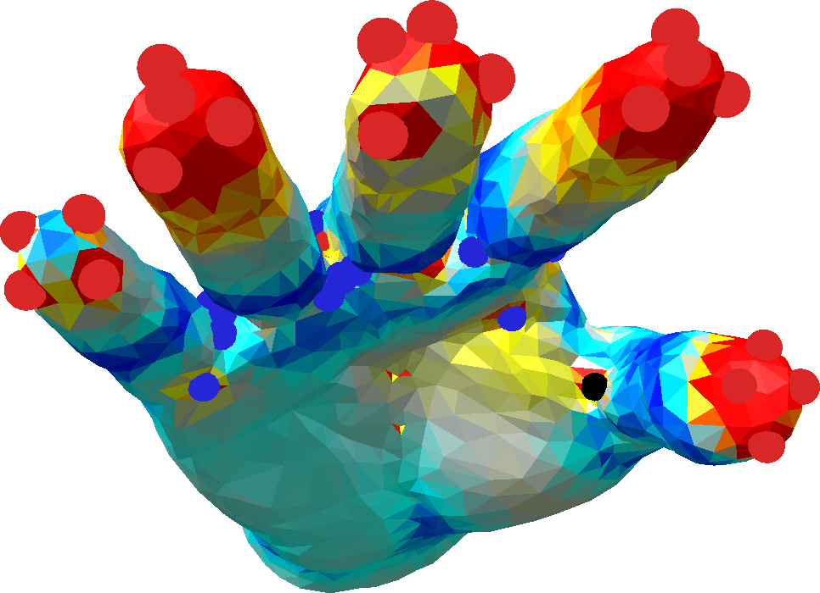
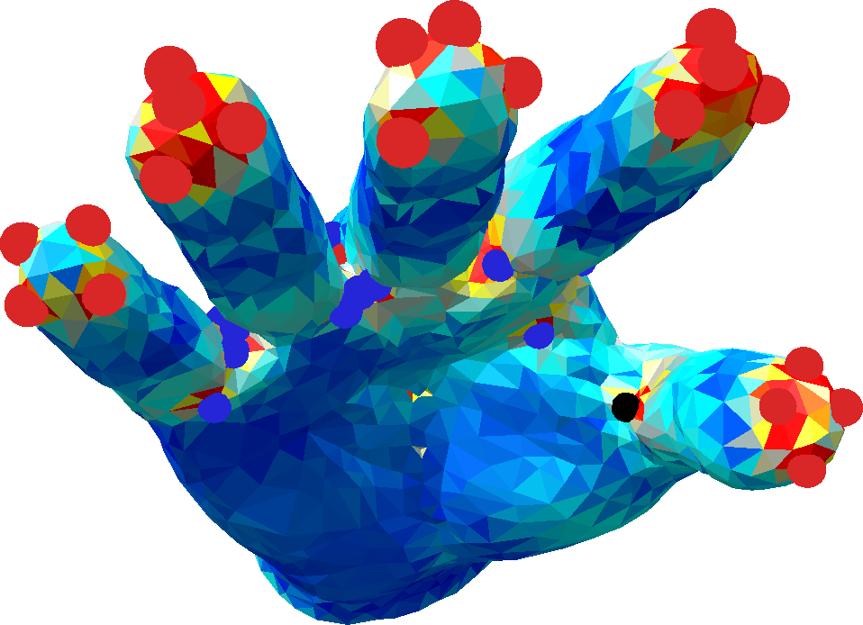
Why leave conformal setting?
Reason 1:
Conformal ⇒ no skew allowed
Can minimize distortion further by allowing skew
ARAP
Conformal
No skew allowed
≈
min_{R,f} ||∇f – R||² (R rotation)
ϕ²

Slide 22
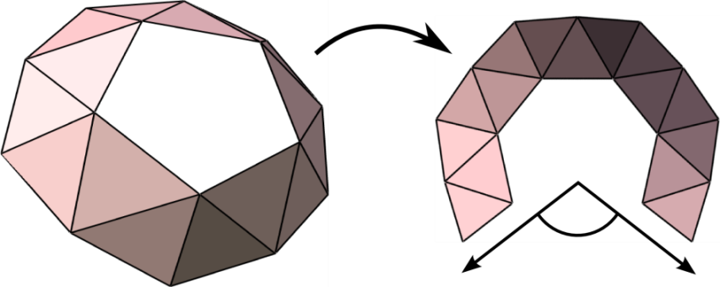
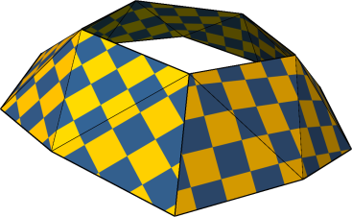
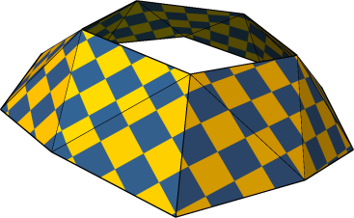
Why leave conformal setting?
Reason 2:
Loop holonomy angle A^{d}
Needs to be a multiple of π/2
Conformal
(Almost) completely determined by curvatures
No degrees of freedom left!
L
A^{d}
unconstrained
rounded A^{d} and translations

Slide 23
Minimize ARAP energy
Input:
Fixed curvatures
Initial parametrization f (conformal)
Further minimize ARAP
min_{R,f} ||∇f – R||² (R rotation)
Local/Global iterations [Liu 2008]
Newton iterations [Chao 2010]
Output: Low-distortion parametrization
Conformal
ARAP

Slide 24
Algorithm summary
Step 1. Flatten and concentrate
Step 2. Round remaining curvature
Step 3. Local/global or Newton
1. Curvature flattening and concentration
2. Iterative rounding of curvatures to multiples of π/2
3. Compute parametrization Further minimize distortion

Slide 25
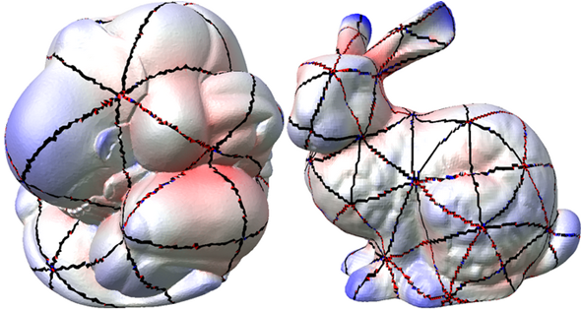
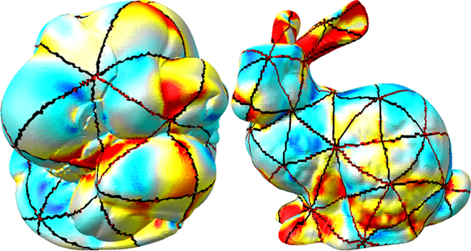
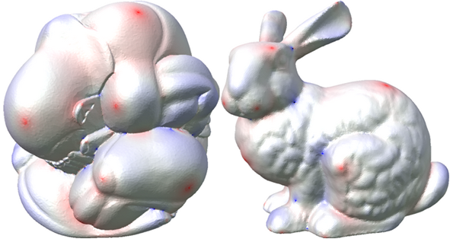
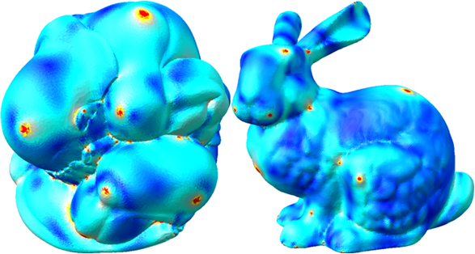
Comparisons with Almost Isomeric Parametrization
Almost Isometric Parametrization [Pietroni 2009]
Iterative Flattening
Area distortion
ARAP distortion

Slide 26
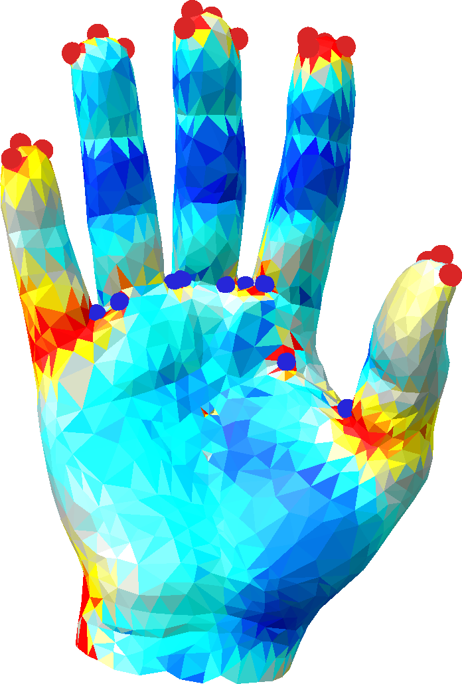
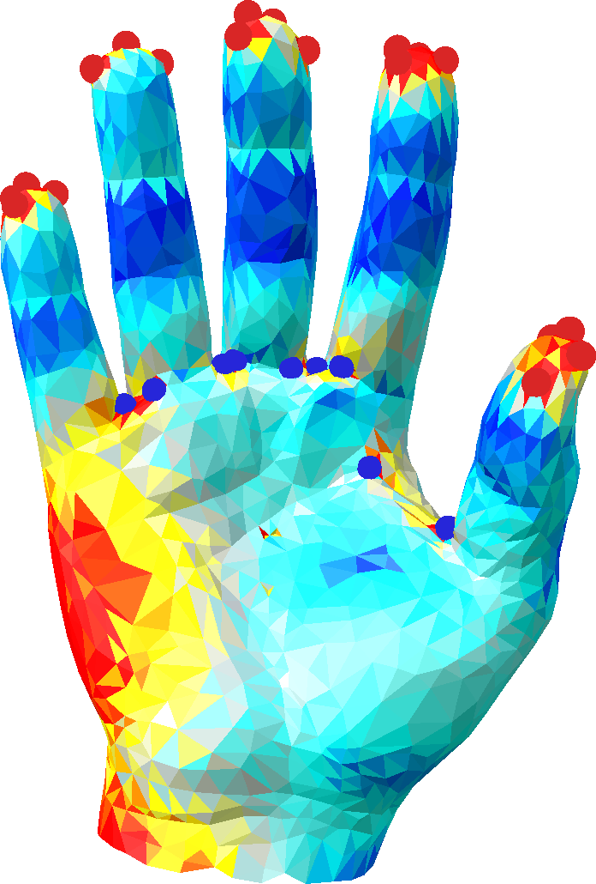
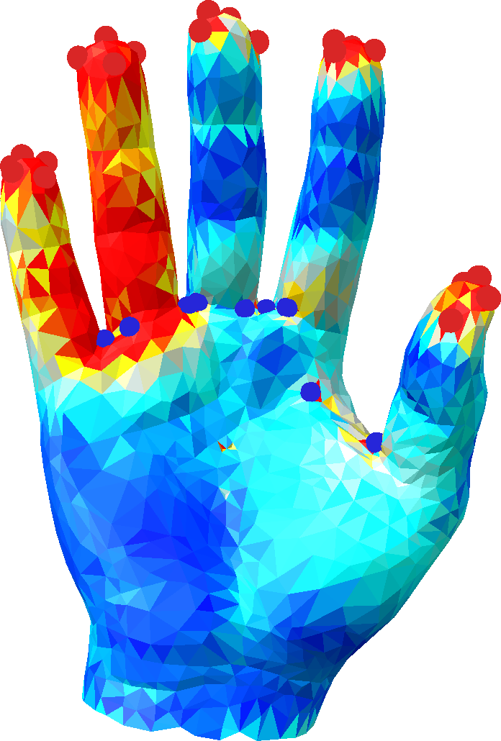
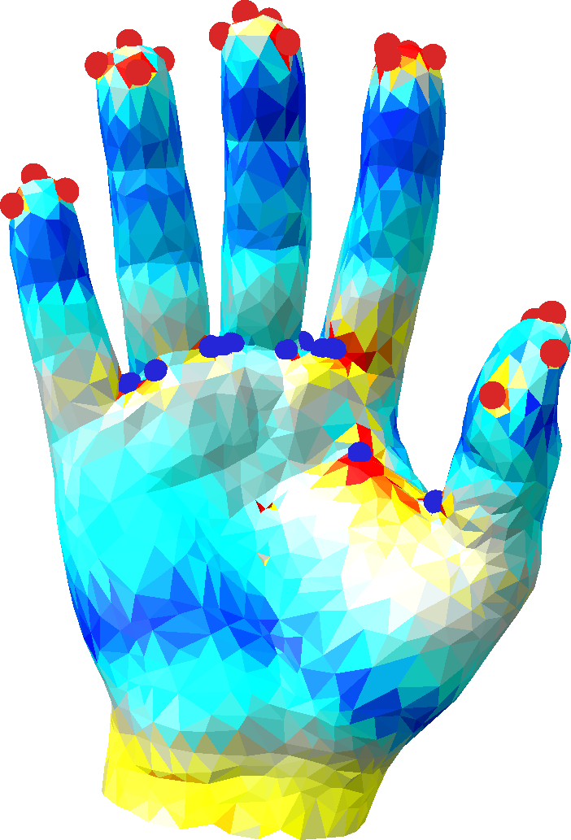
Comparison to top-down approaches
[Ben-Chen 2008], [Springborn 2008]
Start with a flat parametrization, high distortion
Keep adding cones until distortion low
Problems
Dramatic changes in distortion/parametrization
No clear strategy for round curvatures
30 cones
33 cones
35 cones
[Ben-Chen 2008] + round cones
gradual, bottom-up
[Springborn 2008] – add N cones then round all

Slide 27
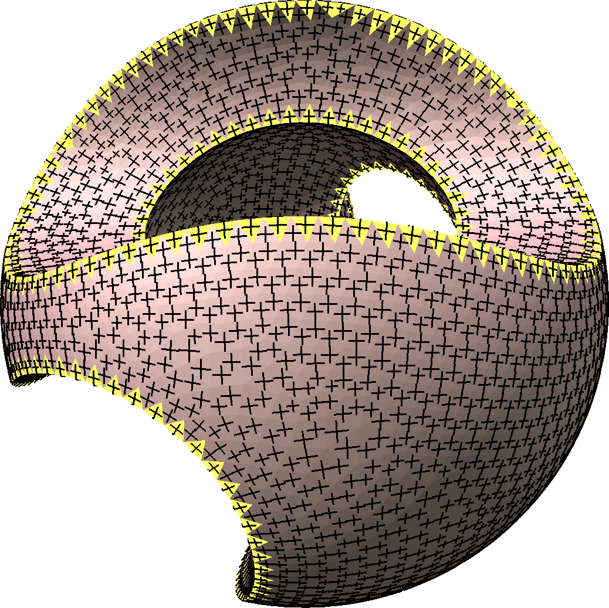
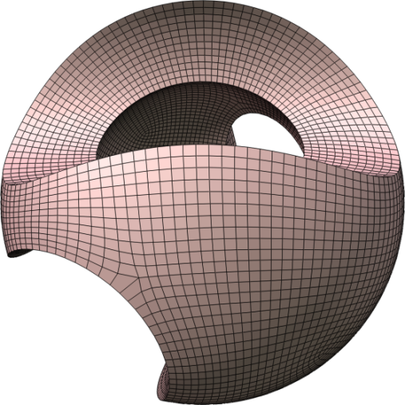
Comparison to field-aligned
Design smooth cross-field PGP [Ray ‘06], [Palacios ‘07], MIQ [Bommes ‘09], Geom-aware [Ray, ‘07]
Field singularities = cone singularities

Slide 28
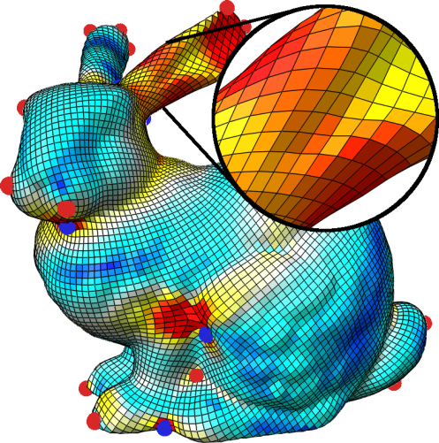
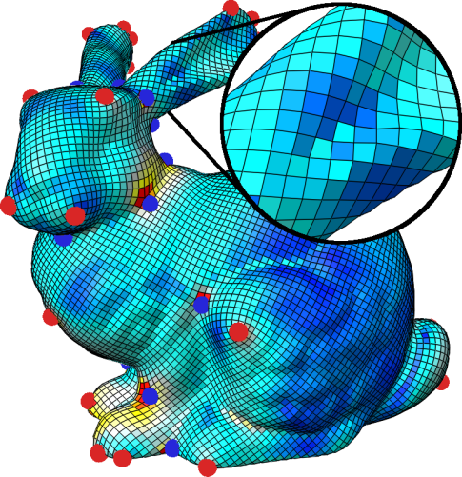
Comparisons with MIQ
(crossfield smoothing, no feature alignment)
May eliminate too many cones
MIQ [Bommes 2009]
36 cones
valence 3 cone
Iterative flattening
44 cones
valence 5 cone

Slide 29
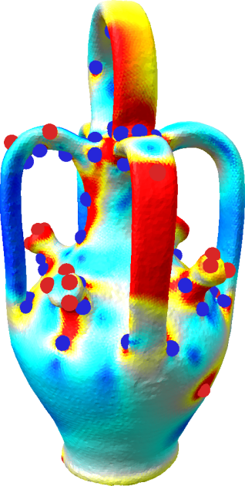
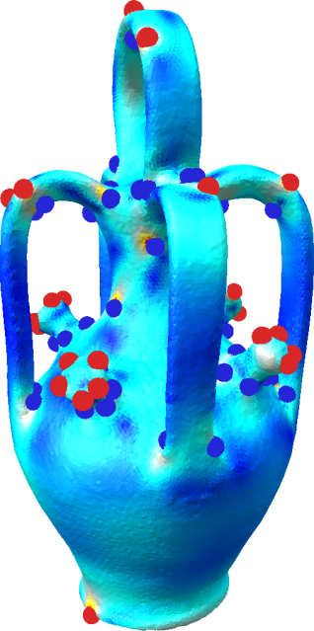
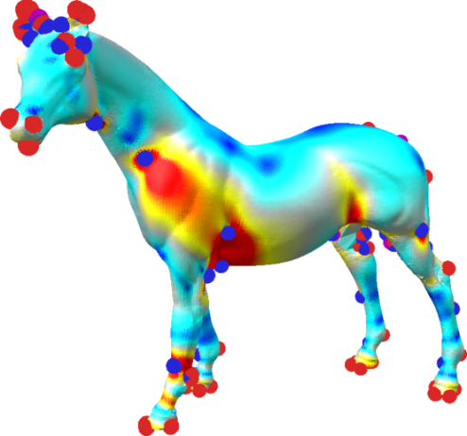
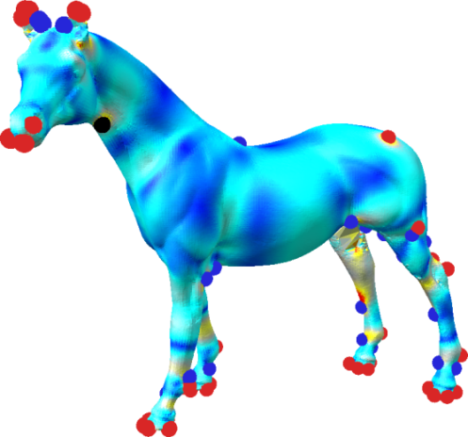
Distortion comparison with MIQ
Shown % triangles with distortion ≤0.2
61%
96%
80 cones
89 cones
61%
90%
60%
91%
71 cones
87 cones
111 cones
70 cones

Slide 30
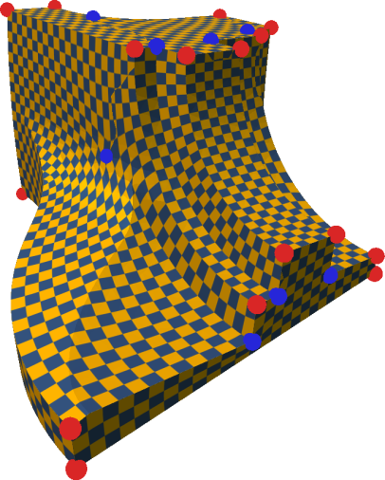
Future work: feature alignment
Feature-aligned MIQ
Unconstrained MIQ
Iterative flattening

Slide 31
Questions?
Step 1. Flatten and concentrate
Step 2. Round remaining curvature
Step 3. Local/global or Newton
Output: Low-distortion parametrization
Future work: Feature alignment
1. Curvature flattening and concentration
2. Iterative rounding of curvatures to multiples of π/2
3. Compute parametrization Further minimize distortion

