Slide 1
Controlled-Distortion Constrained Global Parametrization
Ashish Myles
Denis Zorin
New York University

Slide 2
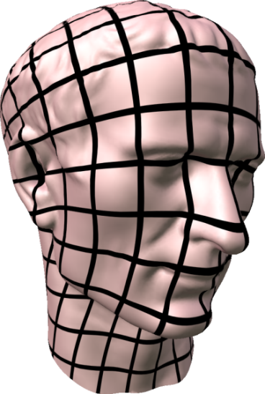
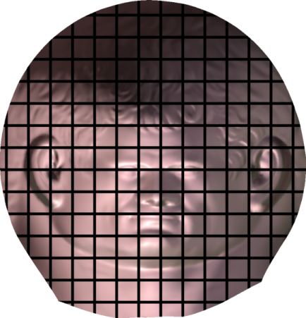
Global parametrization
Map surface to plane
Quadrangulation, remeshing
Geometry images
Smooth surface fitting
Texture/bump/displacement mapping

Slide 3
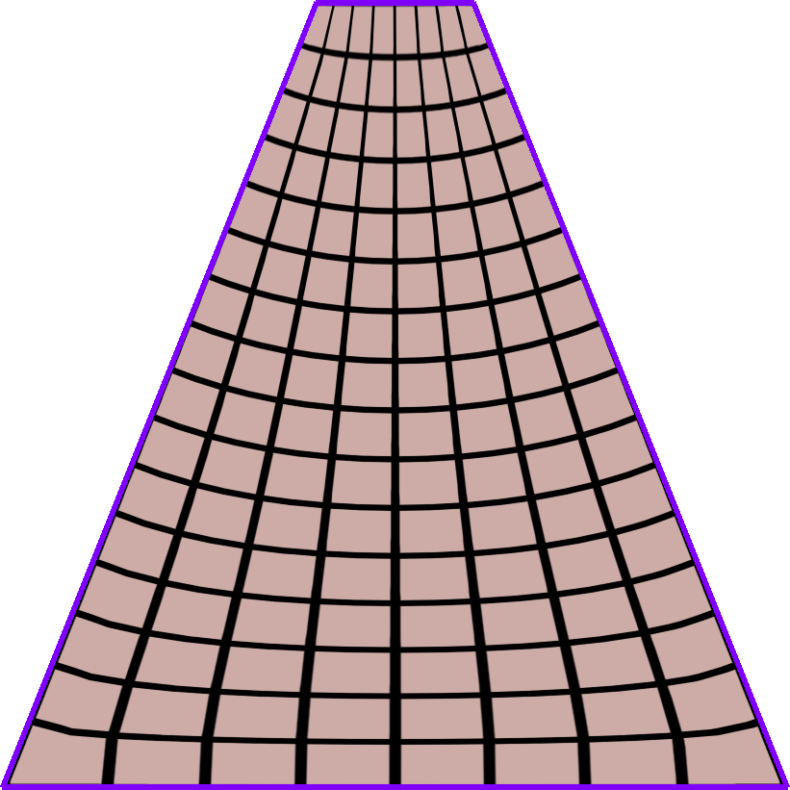
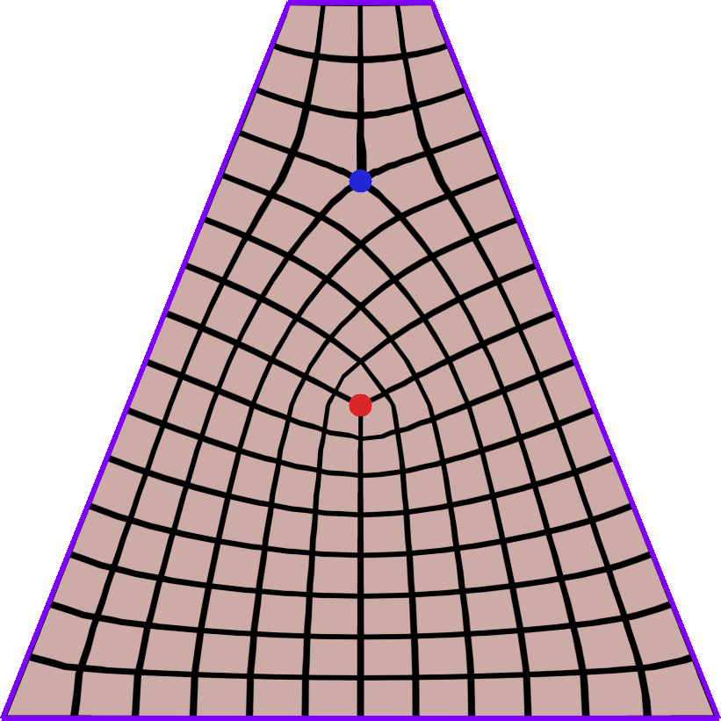
Goal: singularity placement
singularities (valence ≠ 4)

Slide 4
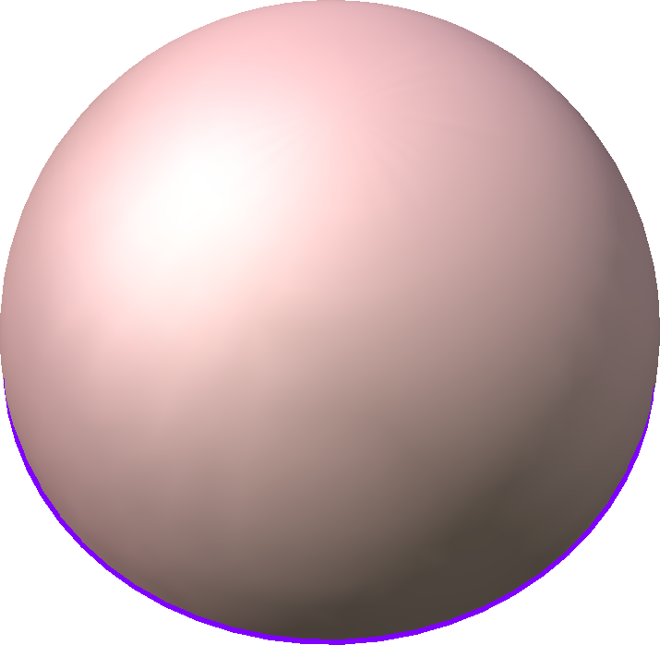
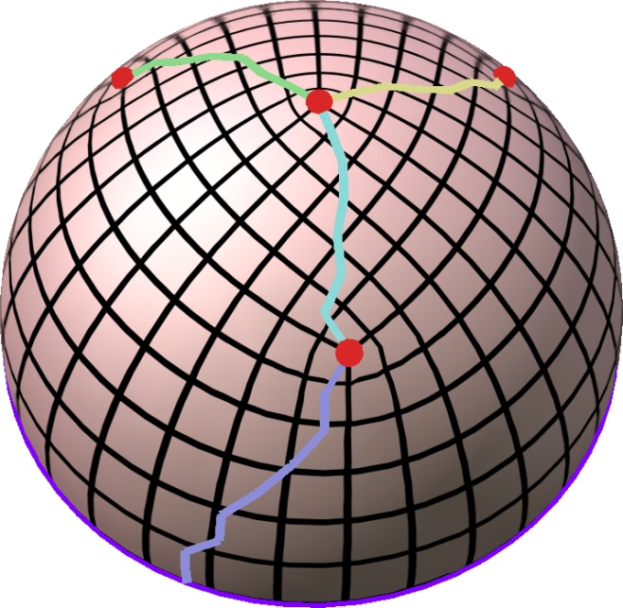
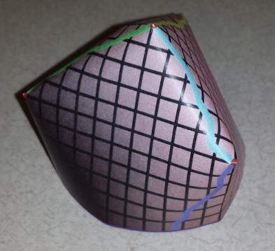
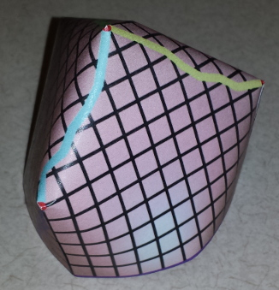
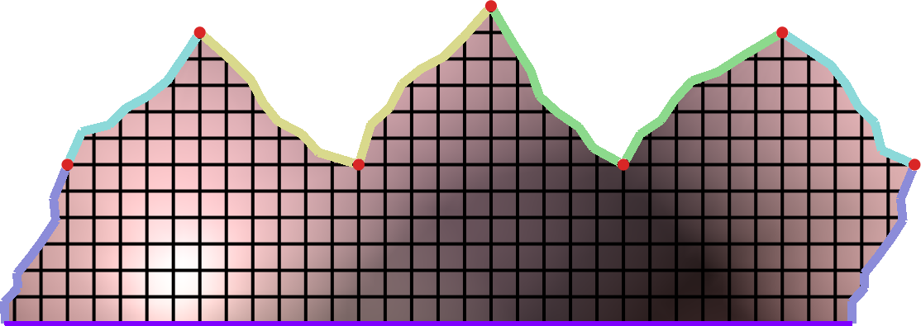
Seamless global parametrization
Requirements
Feature alignment
Map feature curves to axis-aligned curves
Seamlessness
All curvatures multiples of π/2
cone singularities (quad valence 3)
Seam-constraints
Parametrize
0 curvature (flat)
Quadrangulate
π/2
π/2
Integrated curvature (angle deficit) π/2
Feature line grid-aligned

Slide 5
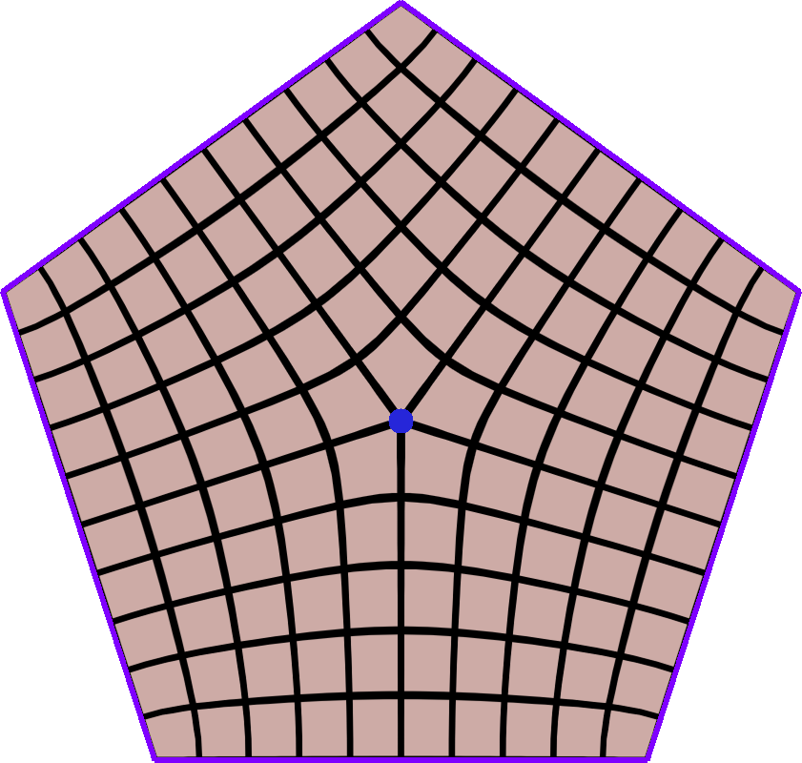
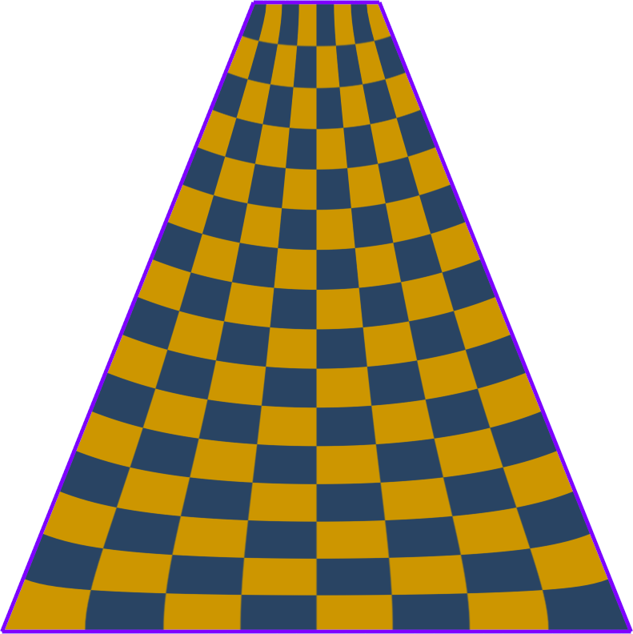
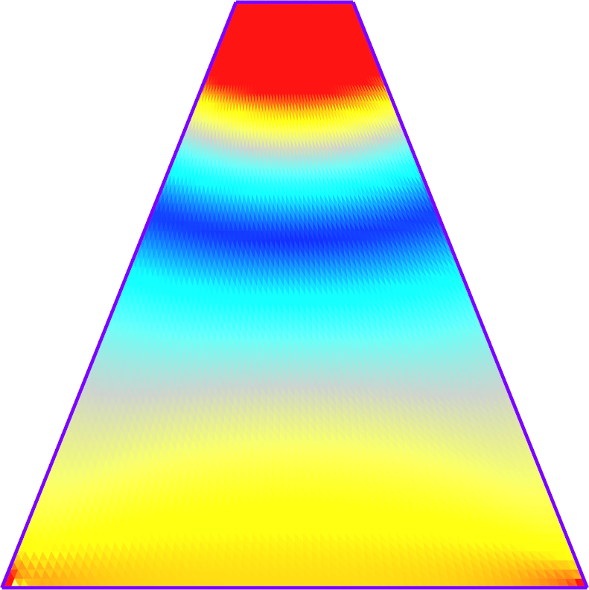
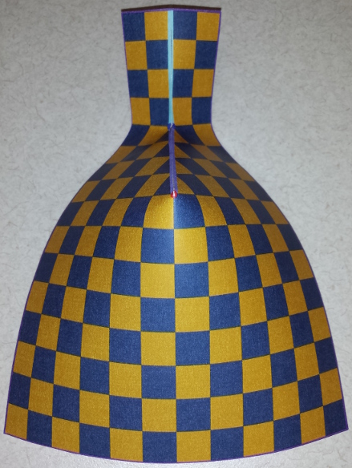
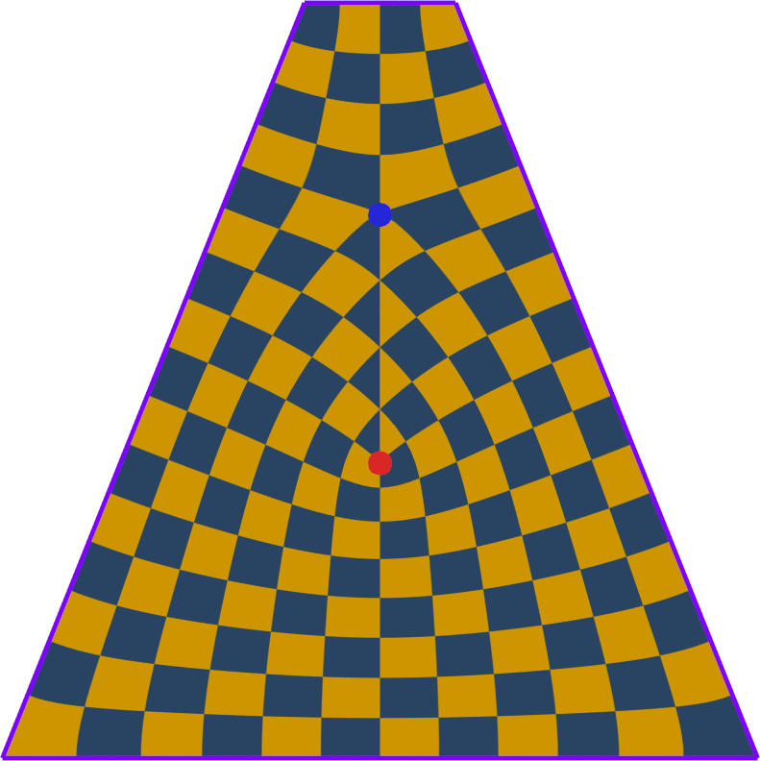
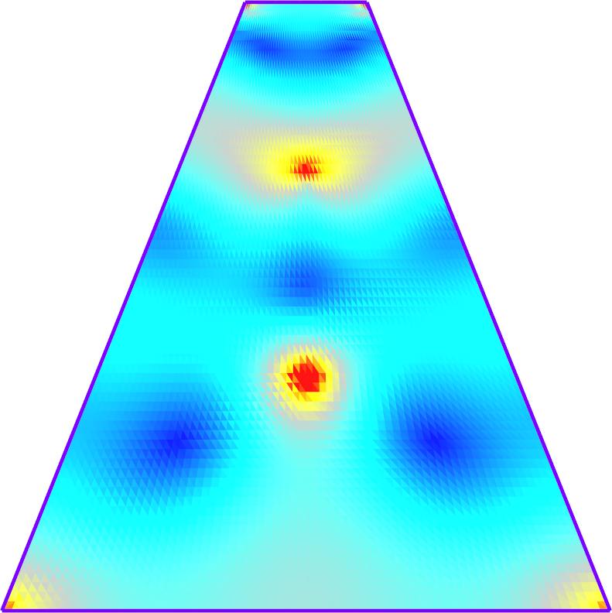
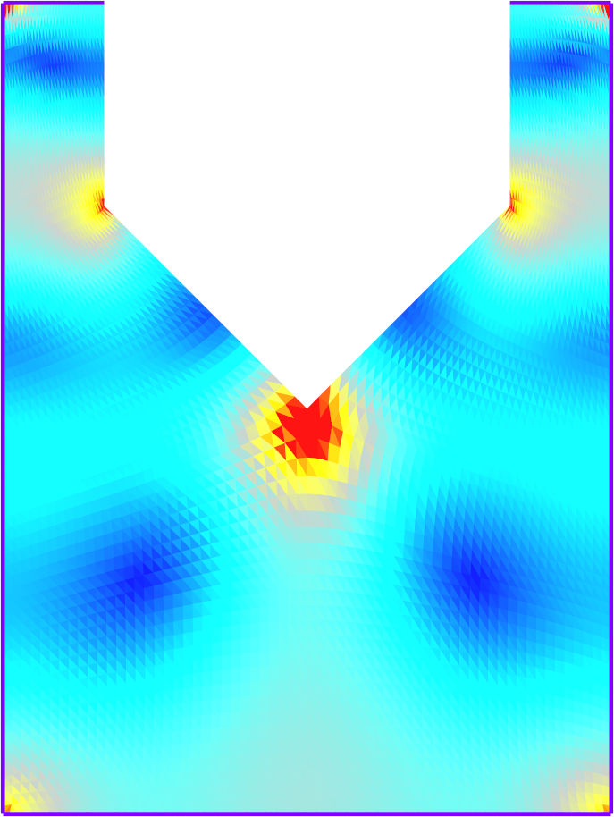
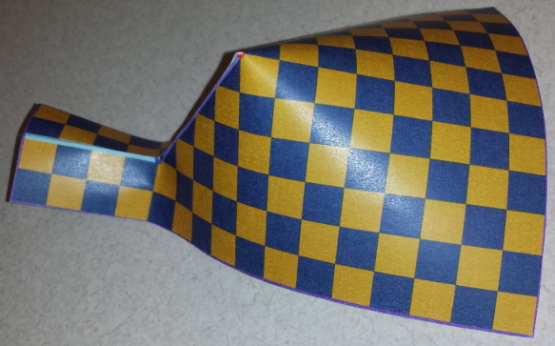
Cones for features and distortion
Cones required to align to features
Distortion induced by feature-alignment
– π/2
0
π/2
π/2

Slide 6
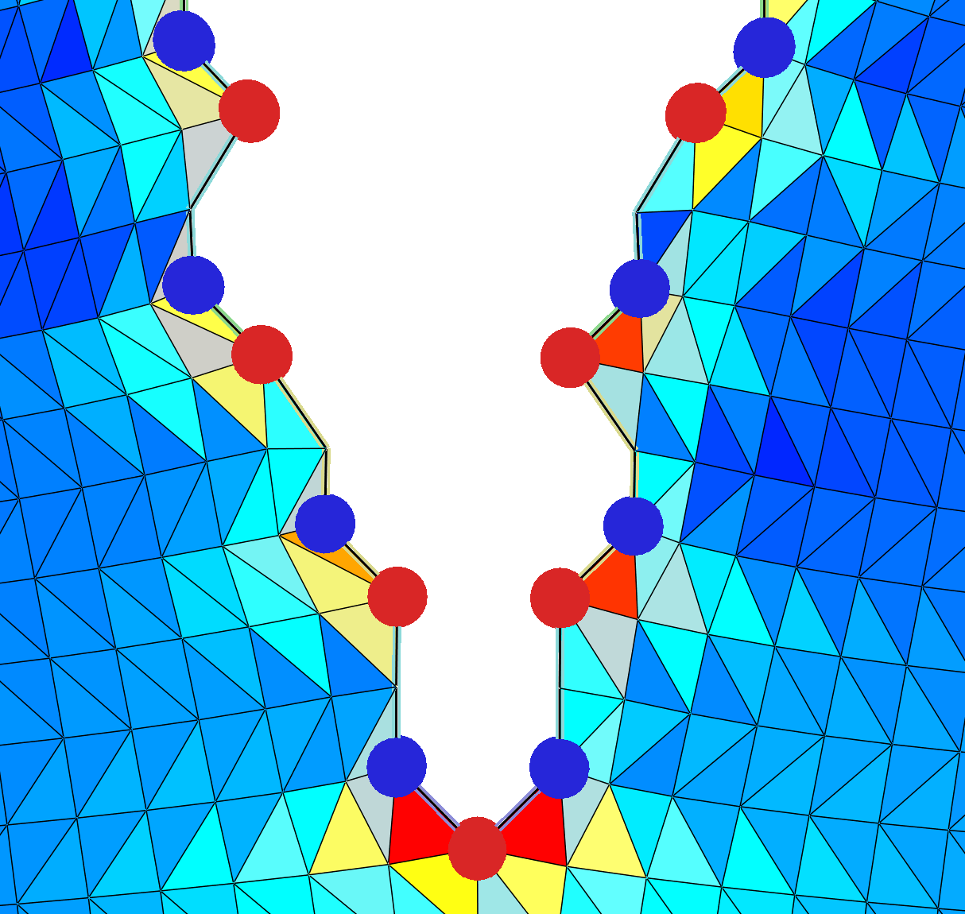
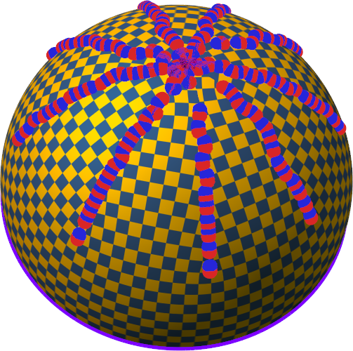
Distortion vs # cones
Proposition 5. For a closed smooth surface with bounded total curvature, and any ϵ > 0, there is a seamless parametrization which has total metric distortion E_{ARAP} < ϵ.

Slide 7
Goal: automatic cone placement
Constraints: (1) seamless (2) feature-aligned
Automatically determine cone locations + curvatures (mixed integer problem)
Trade off parametric distortion with number of cones.
No cones High distortion Bad
2 cones Low distortion Good

Slide 8
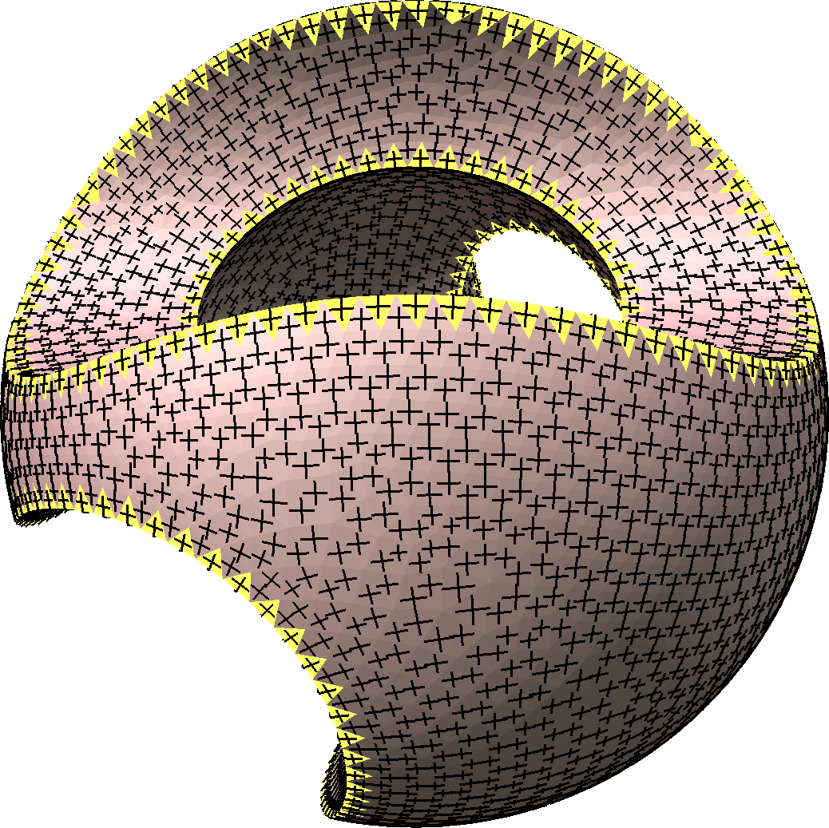
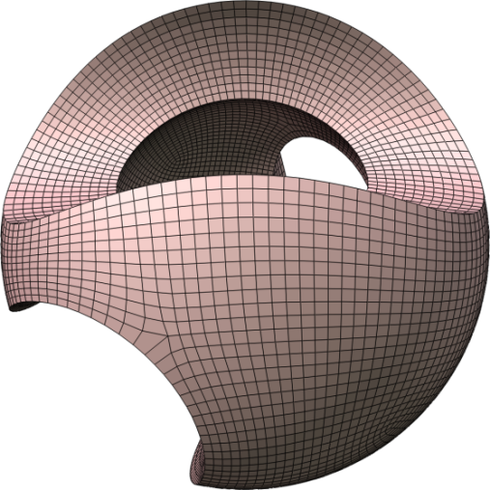
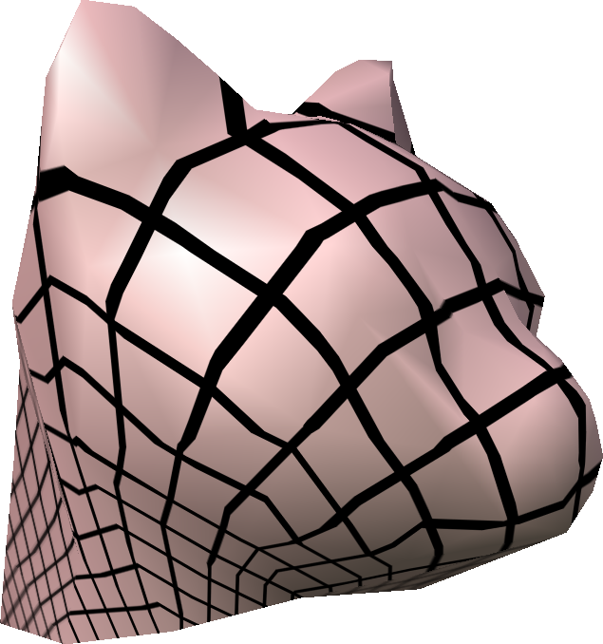
Contribution: Unification of techniques
Cross-field smoothing
Conformal maps
scale by e^{ϕ}
Easy feature alignment
No direct distortion control
ϕ²
Easy to measure distortion
Over-constrained for multiple features
cross-field rotation
∗ω = dϕ + ∗h
closest conformal map

Slide 9
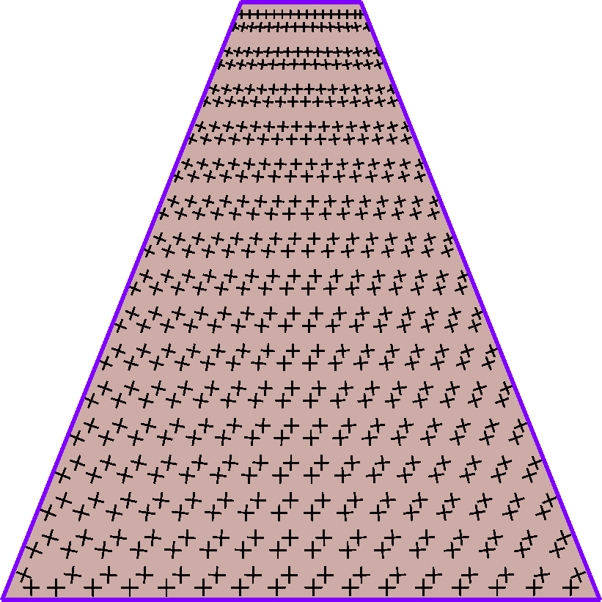
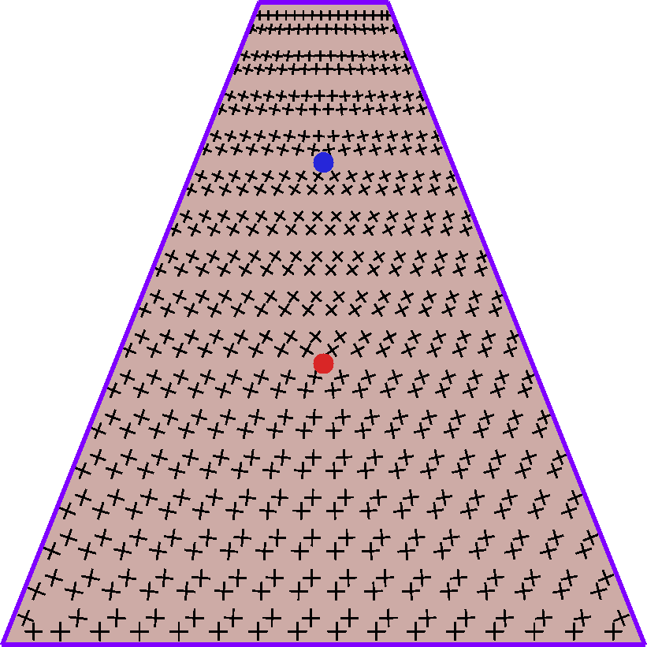
Smooth cross-field not distortion-aware

Slide 10
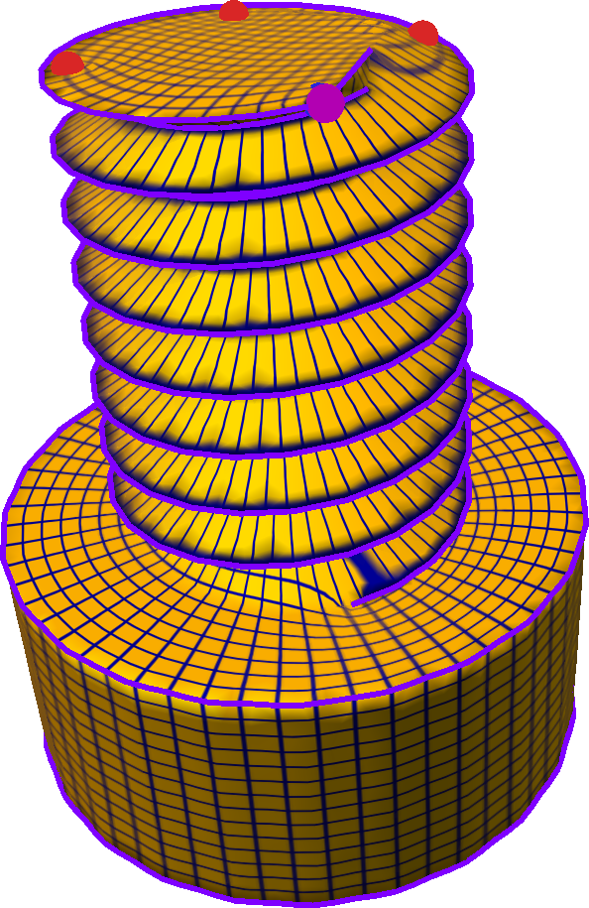
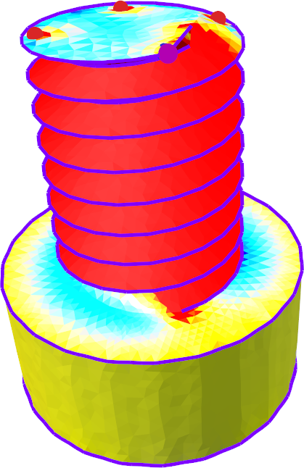
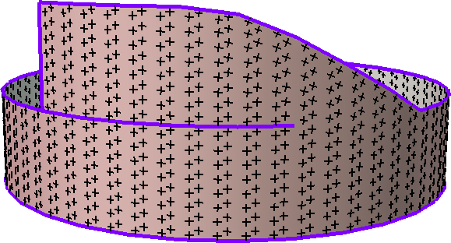
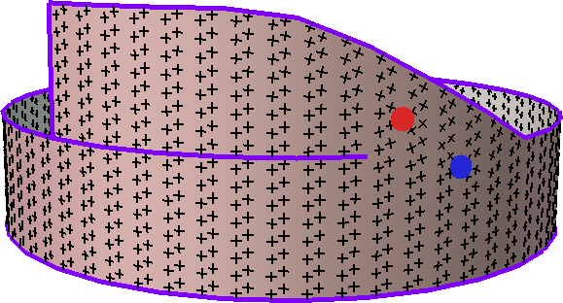
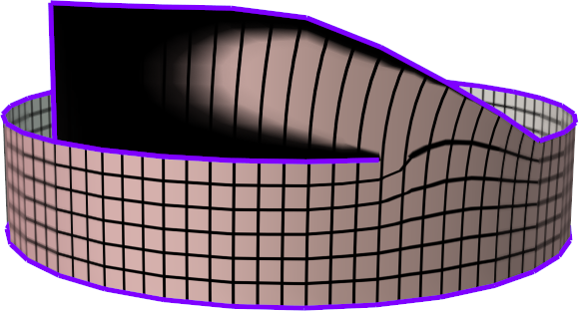
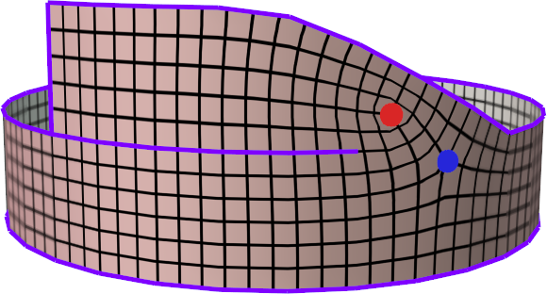
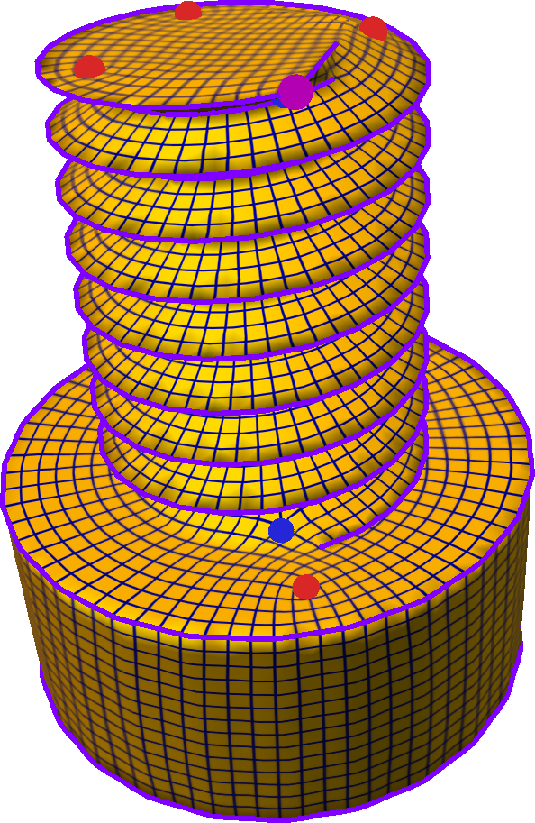
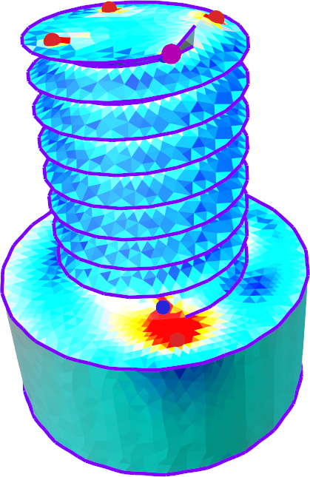
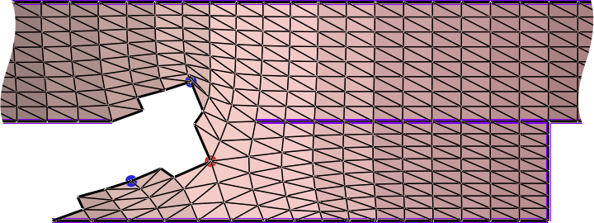
Smooth cross-field not distortion-aware
23 cones
31 cones
parametric domain
collapsed region
To avoid collapse

Slide 11
Conformal maps: over-constrained
Seamless + feature-alignment constraints
Internal curvature –∇²ϕ = K_{new} – K_{orig}
Feature line curvature ∇_{n}ϕ = κ_{new} – κ_{orig}
Relative alignment constraints
Conformal maps cannot handle condition 3.
But cross-fields can.
Completely determine ϕ
Surface already satisfies 1 and 2.
– π/2
0
π/2
0 boundary curvature
π/2 boundary curvature
π/2

Slide 12
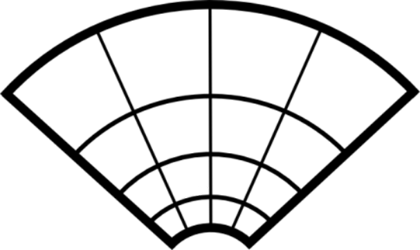
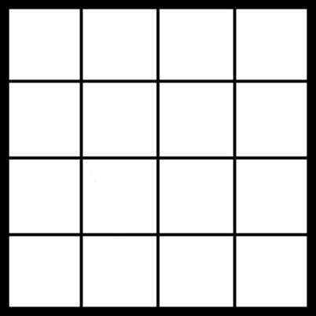
Relation of conformal to cross-fields
Conformal map
scale by e^{ϕ}
rotate by e^{iθ}
Simple 2D case ∇θ⊥ = ∇ϕ (∇θ computes field rotation)
3D surfaces (exterior calculus) ∗ω = dϕ (Connection form ω ∼ ∇θ) [Crane et al. 2010]

Slide 13
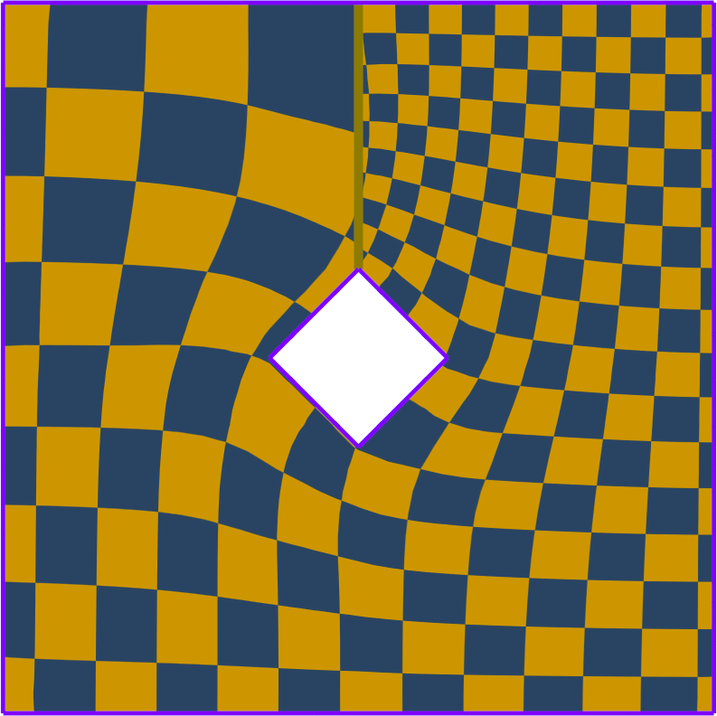
Conformal + Cross-field
∗ω = dϕ + ∗h
cross-field rotation
closest conformal map
harmonic part
Interpretation of harmonic part:
Not seamless!
Distortion ||ϕ||² only accurate if ||h||² low
Need to minimize ||h||²
Constant scale across

Slide 14
System setup and solve
Compute ∗ω = dϕ + ∗h (determines cross-field)
Minimize energy ||ϕ||² + α ||ω||²
Satisfy linear constraints for seamlessness and alignment
Minimize ||h||² (gives linear equations)
Mixed Integer problem
Integer variables (curvature, relative-alignment)
Solve via iterative rounding (similar to [Bommes 2009])
(distortion)
(cross-field smoothness)
Quadratic energy
Linear constraints

Slide 15
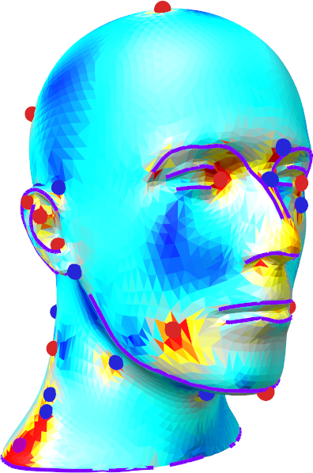
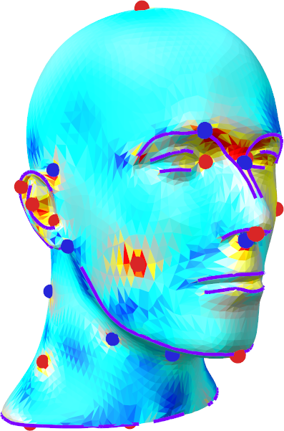
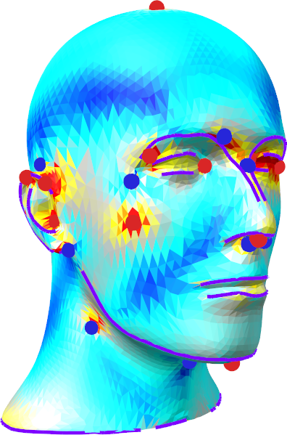
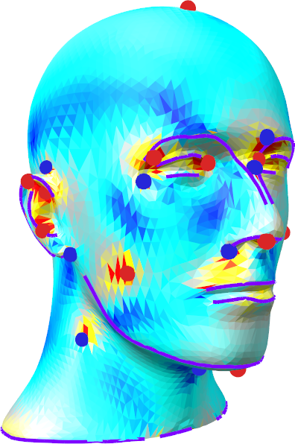
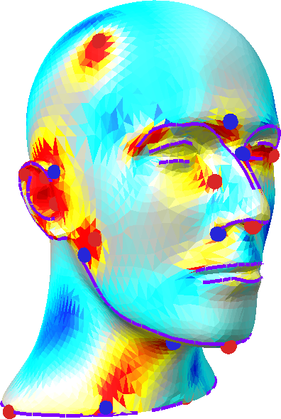
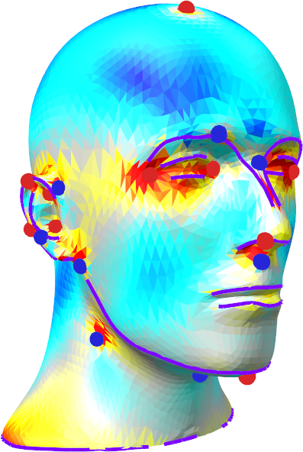
0.6
α = 0.001
90 cones
α = 0.01
66 cones
α = 0.1
47 cones
α = 1.0
44 cones
0.0
α = 100
32 cones no harmonic minimization
Field smoothing [Bommes 2009]
32 cones

Slide 16
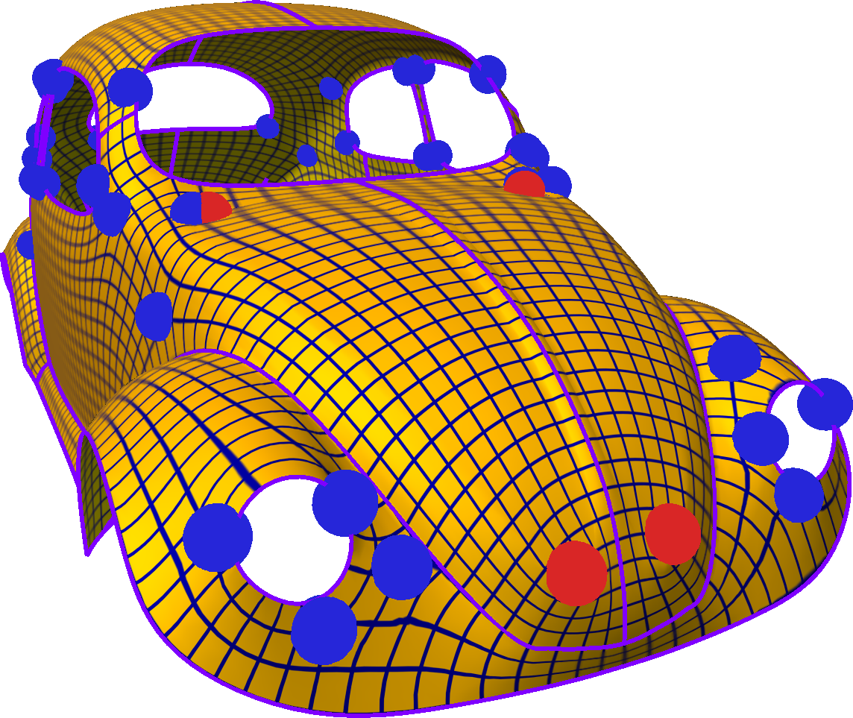
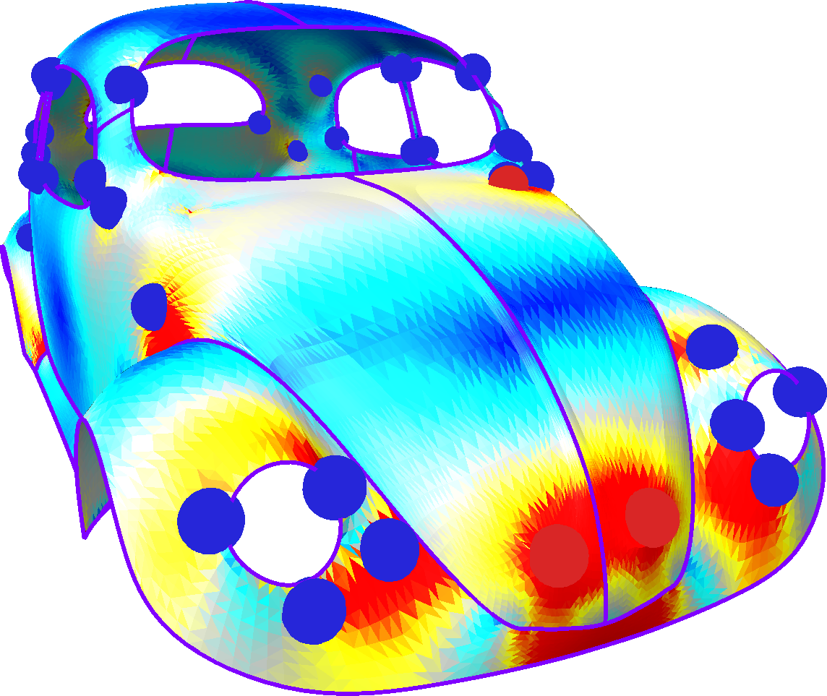
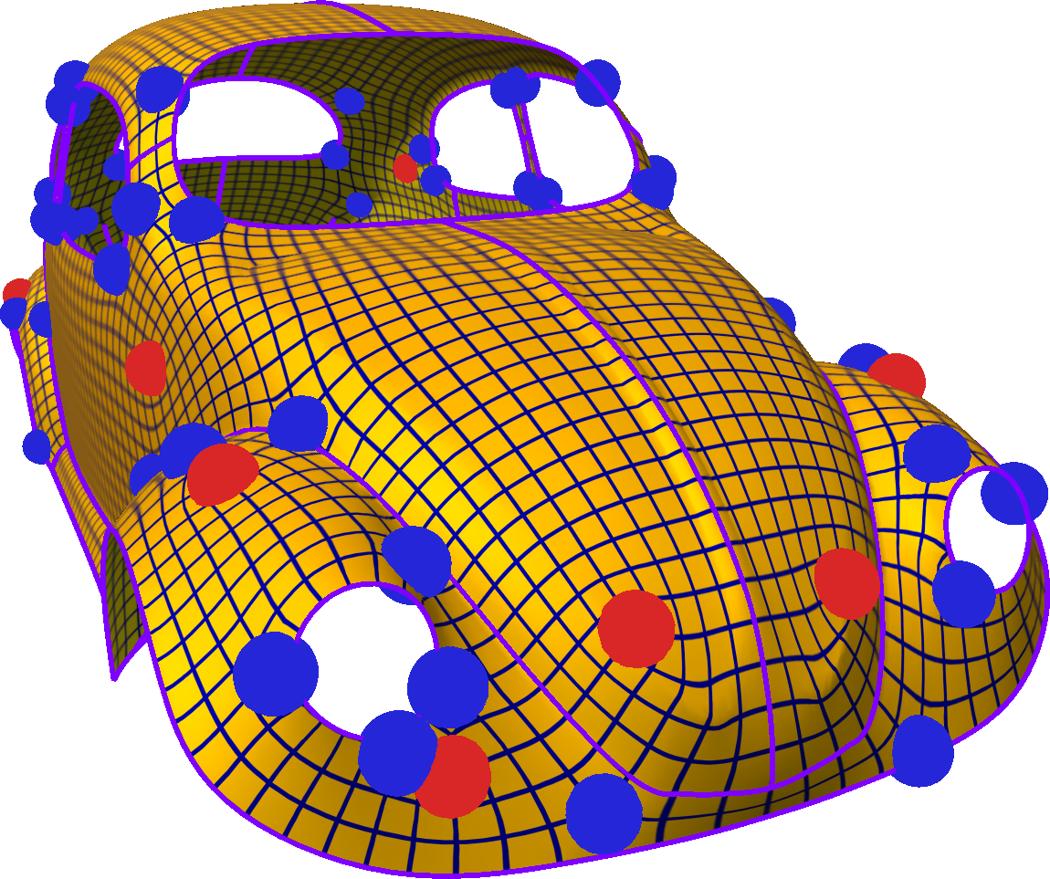
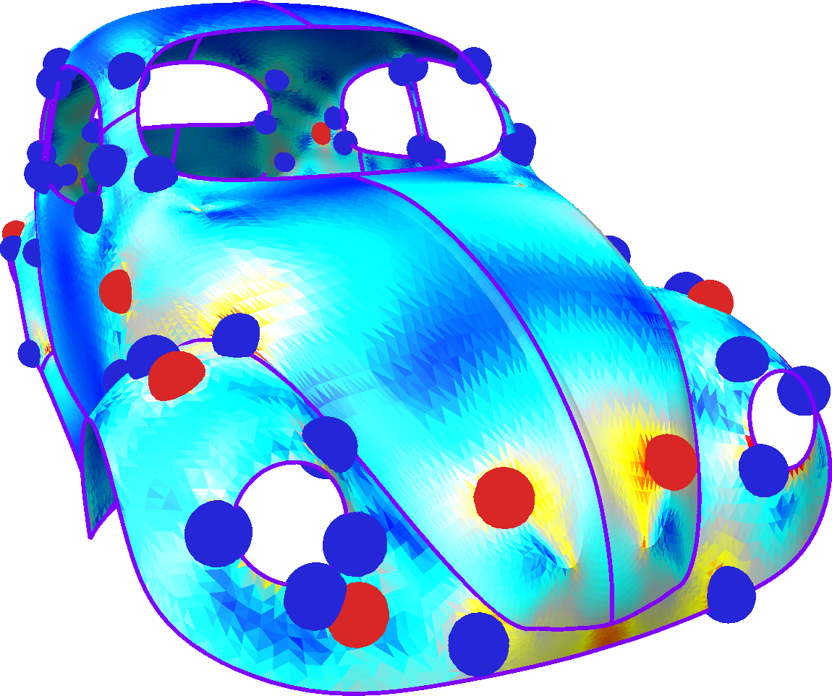
Comparison to cross-field smoothing
50 cones
0.6
Field smoothing
[Bommes 2009]
72 cones
Ours
0.0

Slide 17
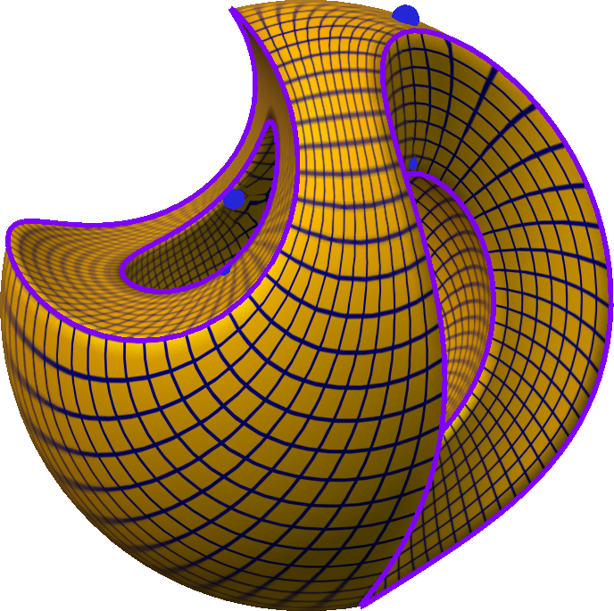
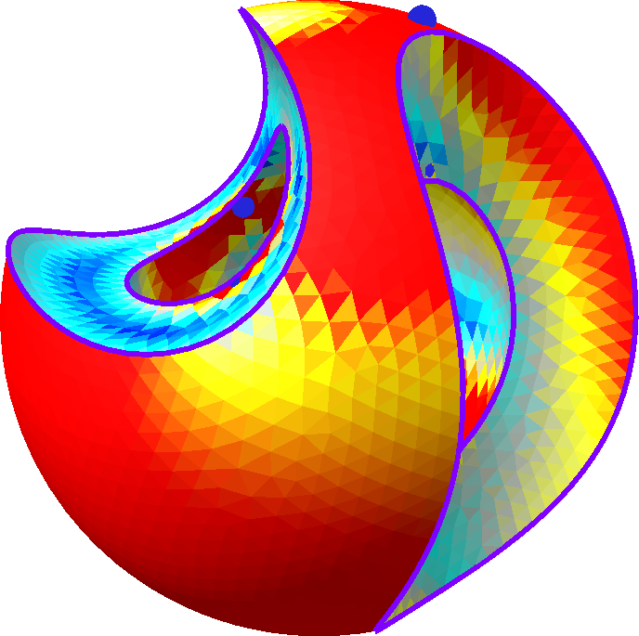
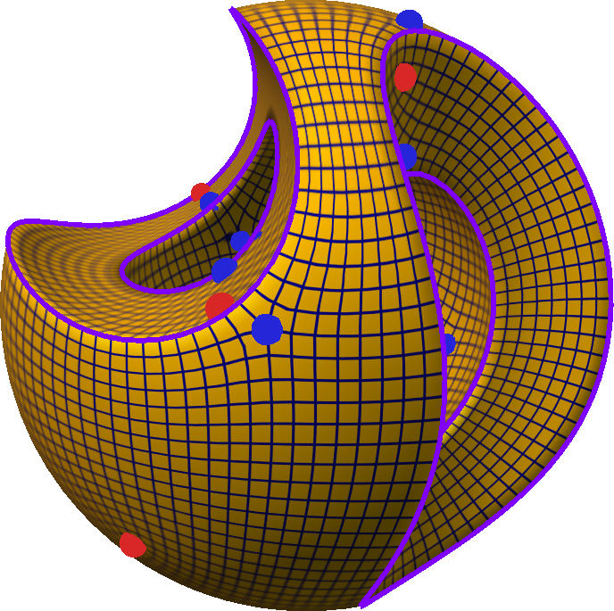
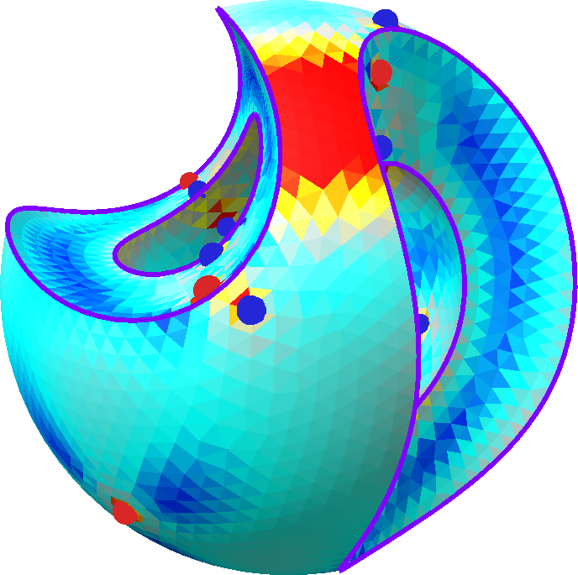
Comparison to cross-field smoothing
Field smoothing
[Bommes 2009]
0.6
Ours
0.0

Slide 18
Comparison to cross-field smoothing
0.6
0.0

Slide 19
Comparison to cross-field smoothing
23 cones
0.6
Field smoothing
[Bommes 2009]
31 cones
0.0
Ours
To avoid collapse

Slide 20
Comparison to cross-field smoothing
0.8
Field smoothing
[Bommes 2009]
30 cones
Ours
0.0
42 cones

Slide 21
Summary
Unification via ∗ω = dϕ + ∗h of 1) cross-field smoothing and 2) conformal approach
Support both 1) feature alignment and 2) distortion control
Trade-off between 1) distortion and 2) # cones

Slide 22
Questions?

