Slide 1
Robust Field-aligned Global Parametrization
Ashish Myles† Nico Pietroni‡ Denis Zorin†
†New York University ‡ISTI, CNR, Italy

Slide 2
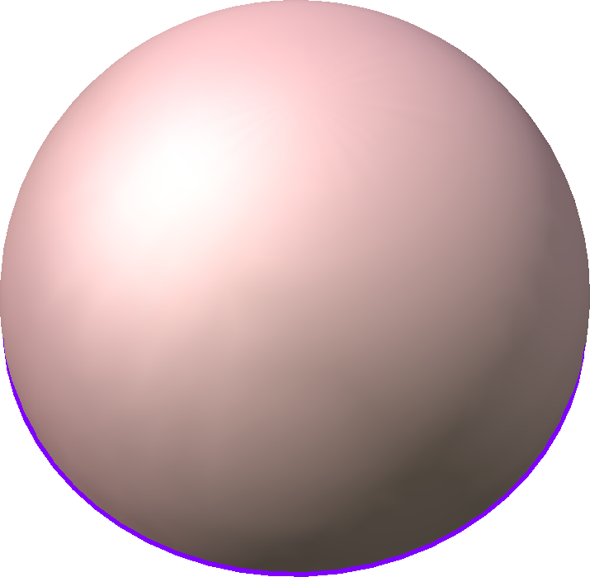
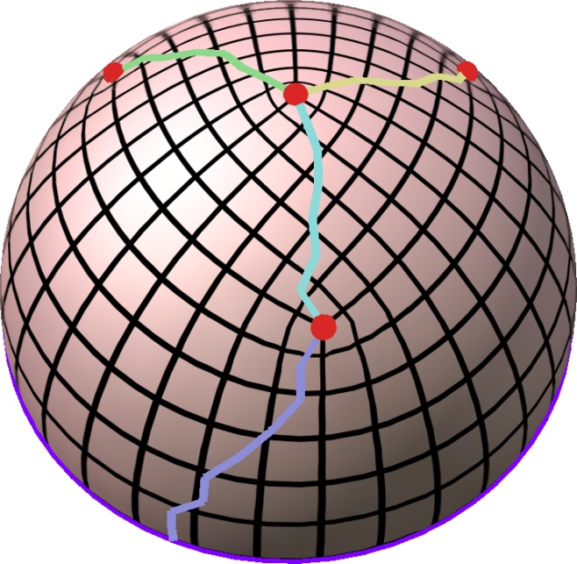
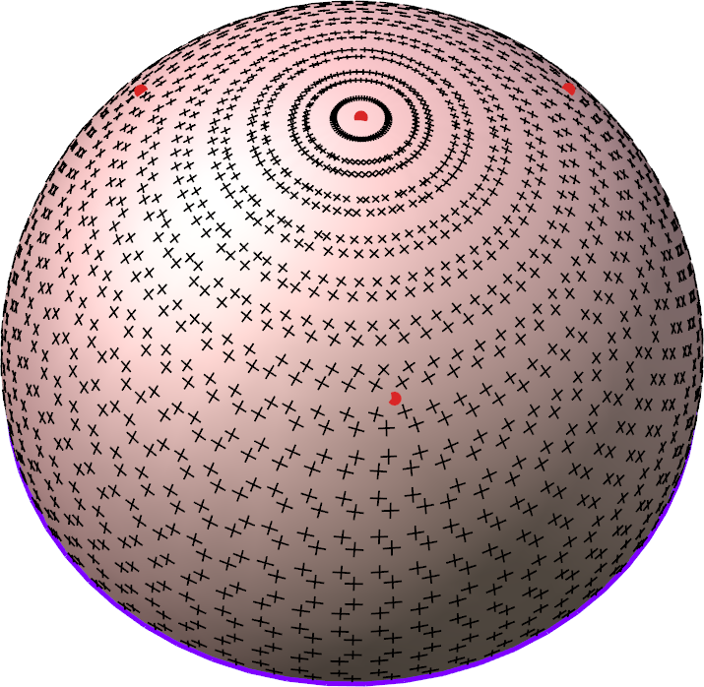
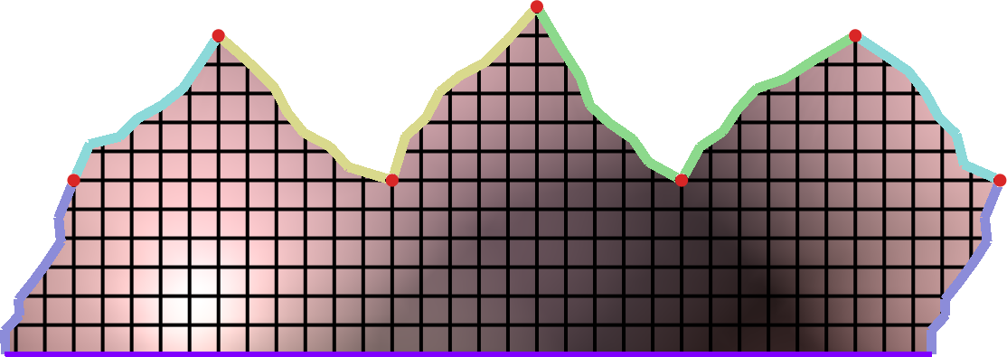
Field-aligned global parametrization
Map from surface to plane
Quadrangulation, remeshing
Geometry images
Texture/bump/displacement mapping
Smooth surface fitting
Map
Grid
π/2
π/2
Parametric domain

Slide 3
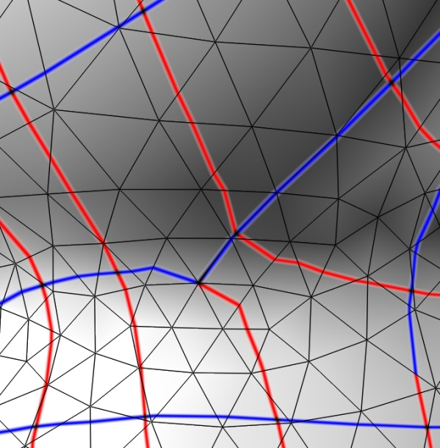
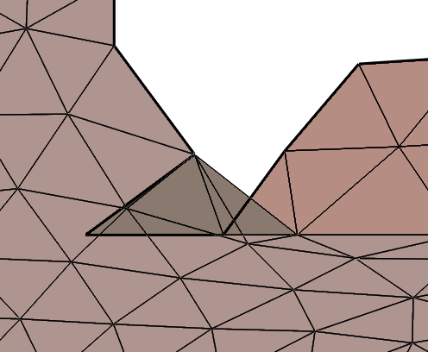
Goal: Robustness
Bijectivity (one-to-one): no foldovers; no collapses
Parametric domain
Surface

Slide 4
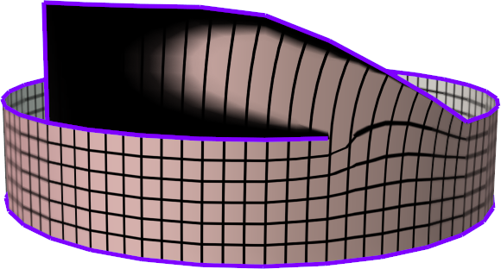
Goal: Robustness
Bijectivity (one-to-one): no foldovers; no collapses
surface
parametric domain
collapsed region

Slide 5
Challenges to attaining bijectivity
Discretization: Insufficient degrees of freedom in the triangle mesh.
Need to be able to refine the surface mesh
Solution space of bijective maps is non-convex.
Convex subspace constraints may have an empty solution space.
[Lipman 2012] (Bounded-Distortion Mappings)
[Bommes 2013] (Integer-Grid Maps)
Cross-field topology: Might not permit a valid parametrization.

Slide 6
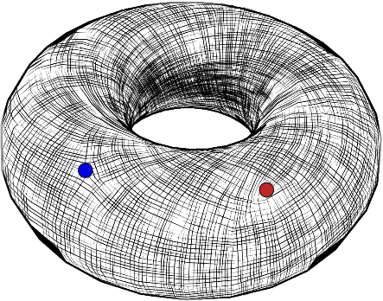
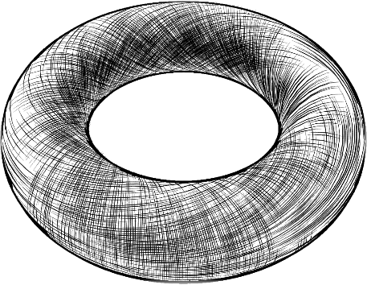
Infeasible cross-fields
Need to be able to introduce or remove singularities
Field rotation 90 degrees

Slide 7
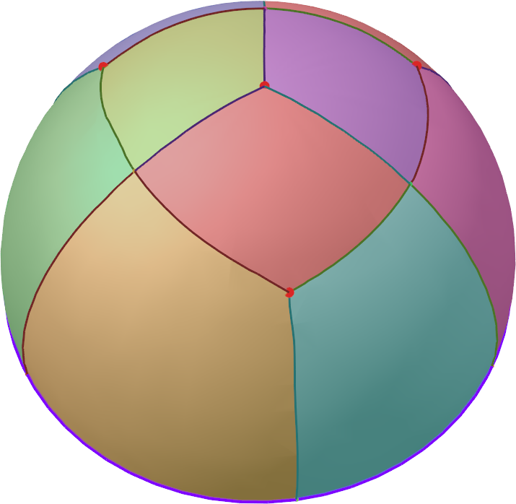
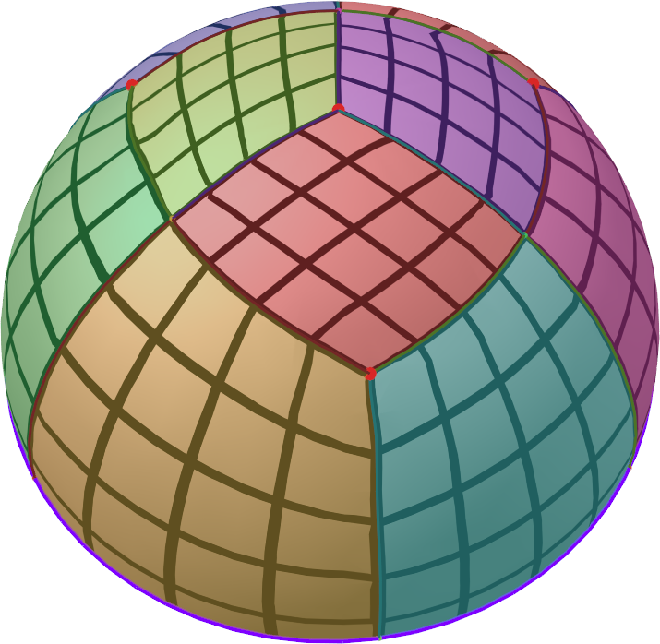
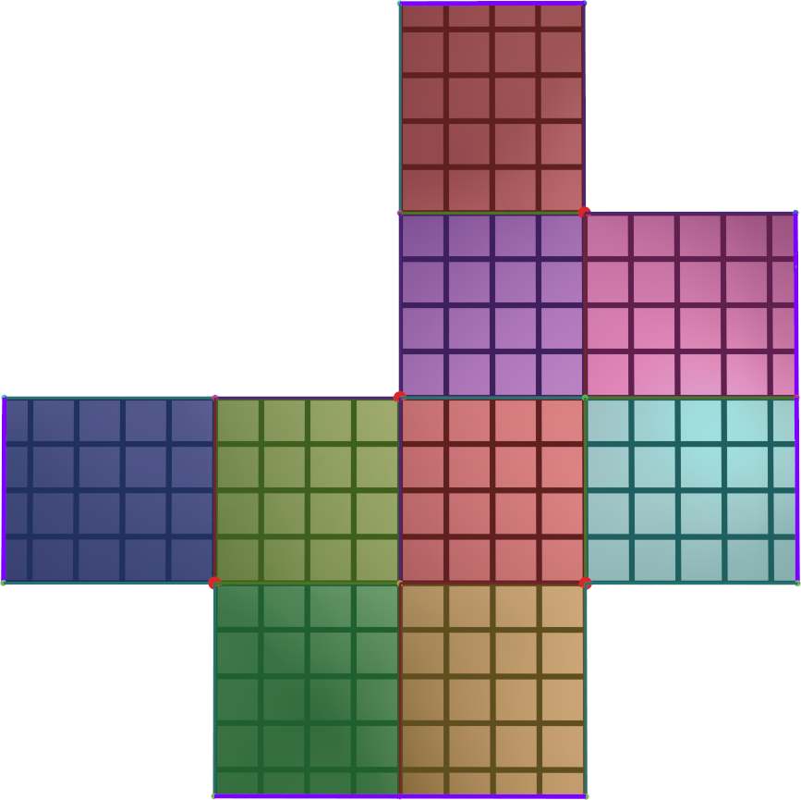
Strategy: Bijectivity
Compute motorcycle graph
Trace field from singularities and ends of feature curves
Stop when colliding with another trace
Map each patch to a rectangle
Bijectivity guaranteed
Must glue together consistently
Parametric domain

Slide 8
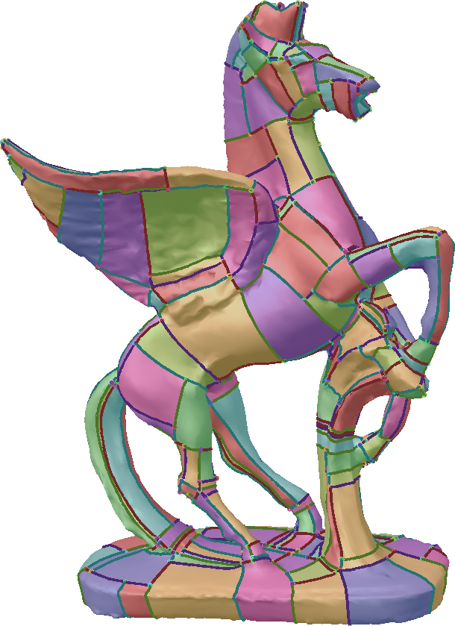
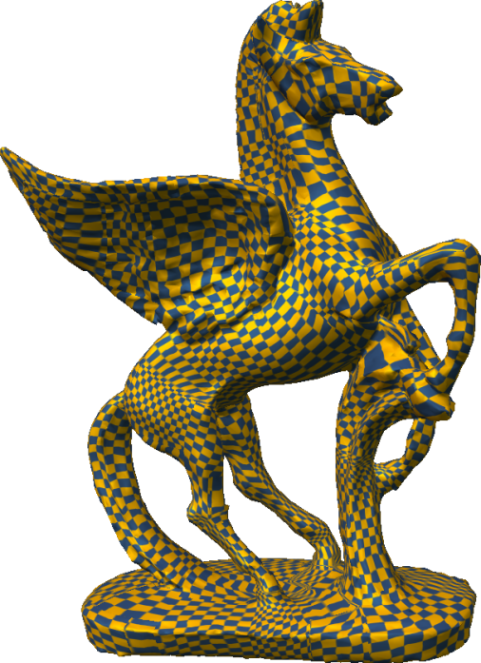
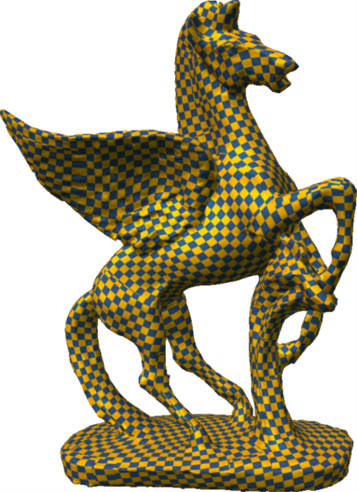
Strategy: Quality
Convex bijectivity constraints [Lipman 2012]
Feature-aligned quad patches
Initial (robust) parametrization
Optimized constrained parametrization [Lipman 2012]

Slide 9
Stage 1: Cross-field tracing

Slide 10
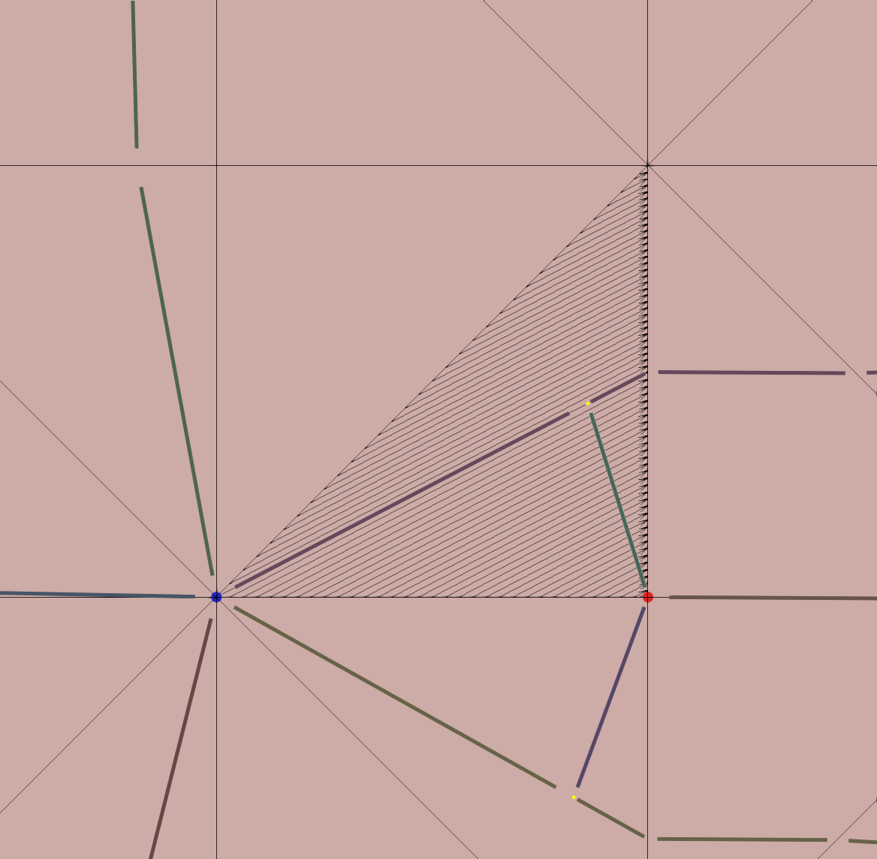
Tracing vector fields
out
Similar to [Ray, Sokolov 2014] (first talk in session)
Additionally,
Piecewise-linear tracing to avoid coinciding traces.
Orthogonal integral lines intersect in the right orientation.
Proof of near-uniqueness of field topological structure for triangles.
out
in
out
in
trigger refinement
✗
✔

Slide 11
Stage 2: Mapping patches to rectangles
Parametric domain

Slide 12
Parametrize T-mesh patch layout
Assign lengths to all T-mesh edges.
Map each patch to a 2D rectangle with assigned lengths.
Must meet consistency constraints v, w, x, y, z > 0 v = w x + y = z
x
y
v
w
Parametric domain
z

Slide 13
Some lengths can be forced to zero
x₄ + y₄ = x₁
x₄ < x₁
y₁
y₂
y₃
y₄
x₁
x₂
x₃
x₄
x₁+ y₁ = x₂
x₁ < x₂
x₂ + y₂ = x₃
x₂ < x₃
x₃ + y₃ = x₄
x₃ < x₄

Slide 14
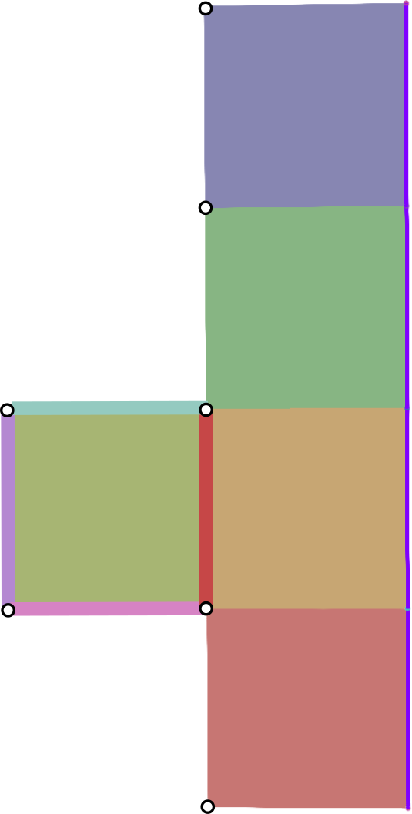
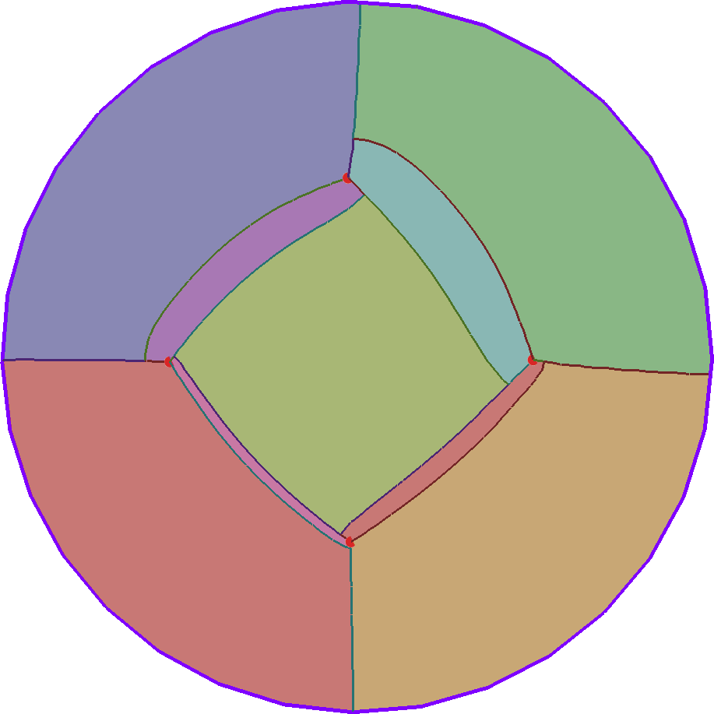
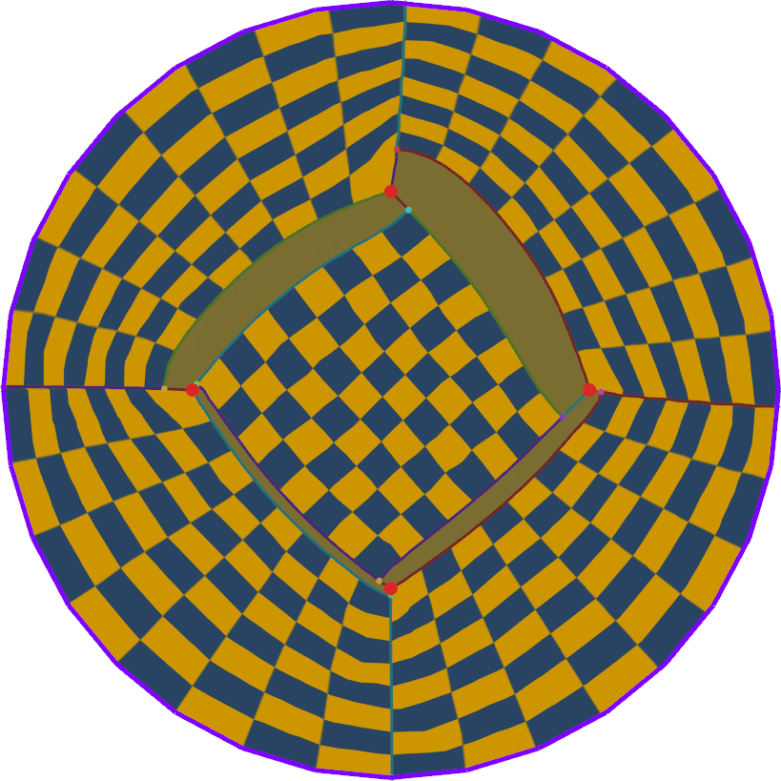
Some lengths can be forced to zero
Motorcycle graph
Parametrization
Parametric domain

Slide 15
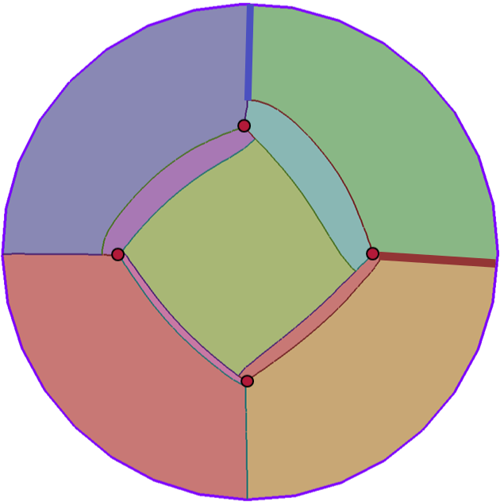
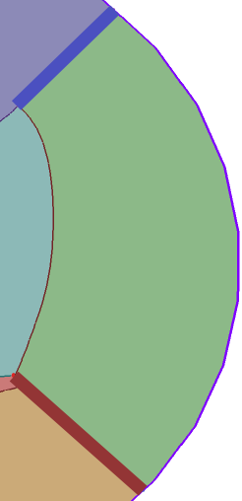
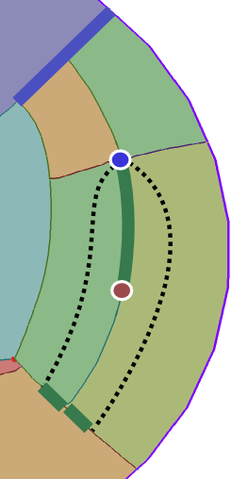
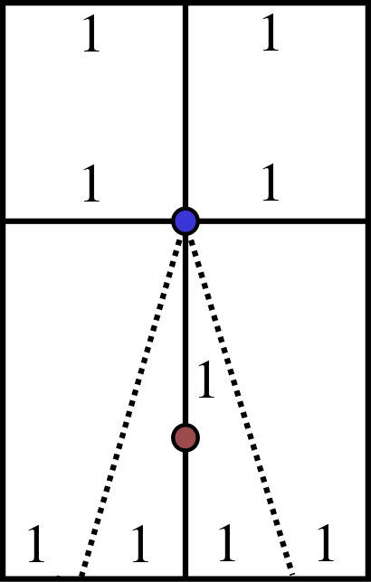
Strategy 1: Introduce cone pairs
Introduce 2-6 singularity pairs (backup plan).
2
1
1
1
Non-zero length assignments with inconsistencies allowed
1
4
1
1

Slide 16
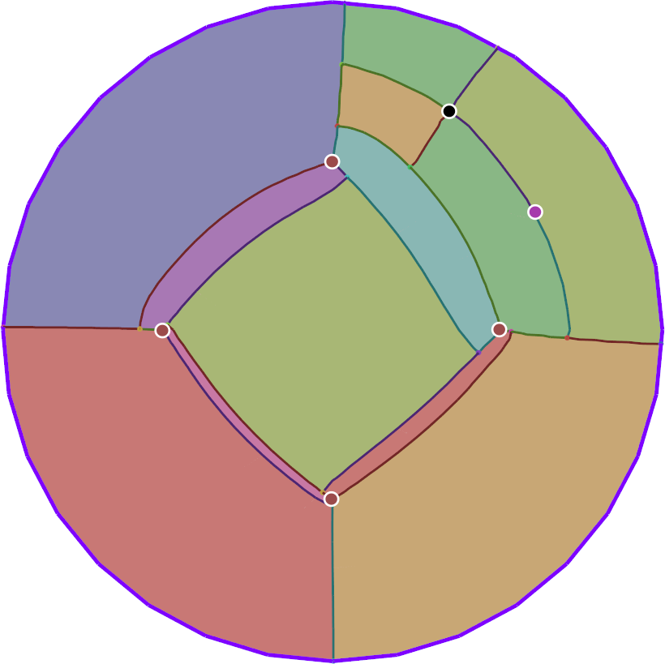
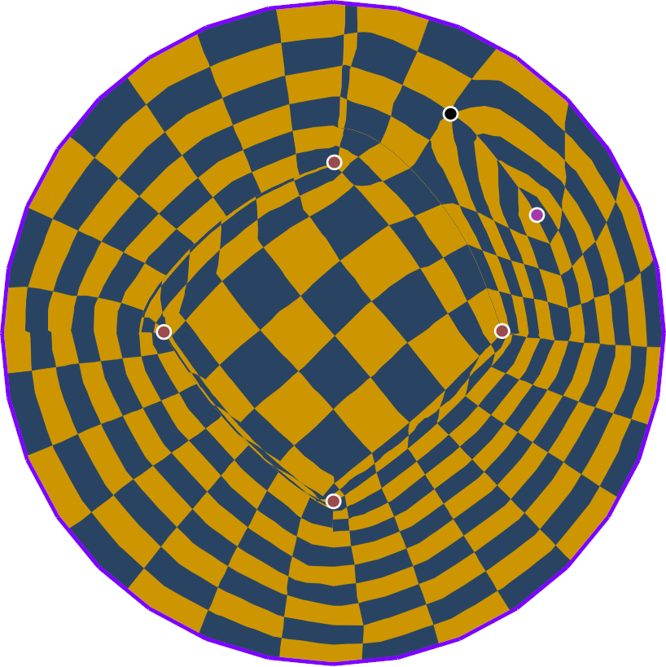
Strategy 1: Introduce cone pairs
Always succeeds, but not always ideal.

Slide 17
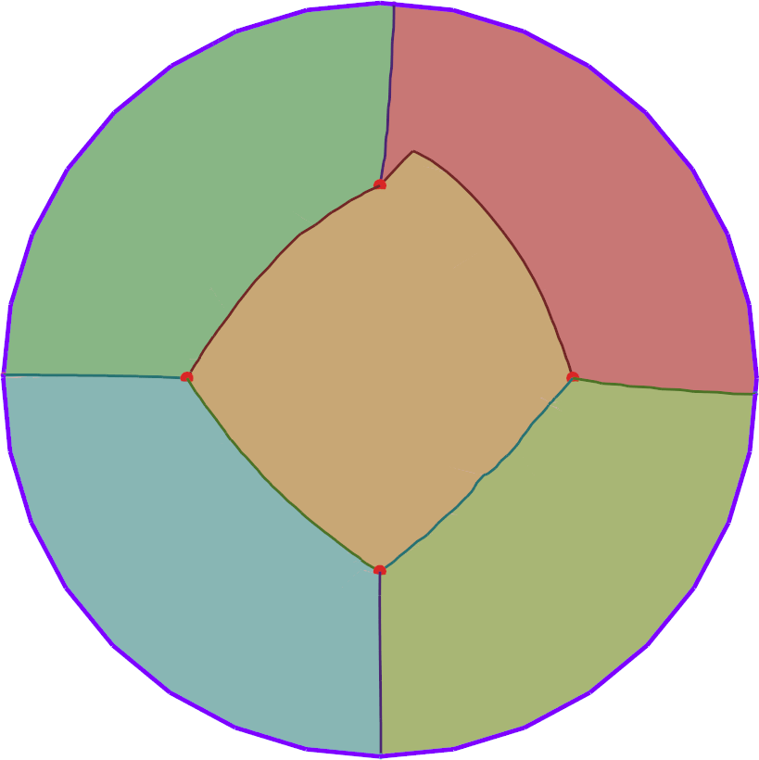
Strategy 2: T-mesh simplification
⇒
Initial layout
Simplified layout
Parametric domain

Slide 18
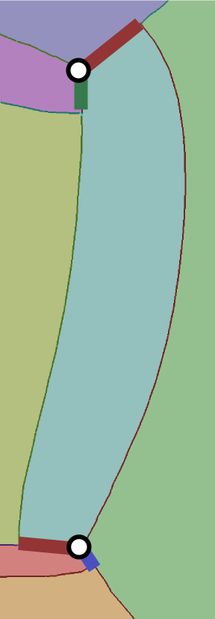
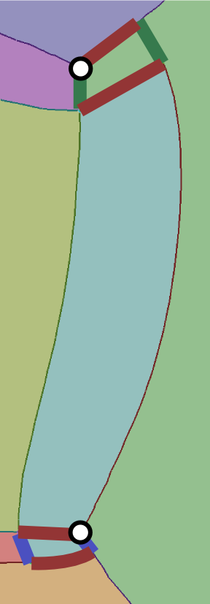
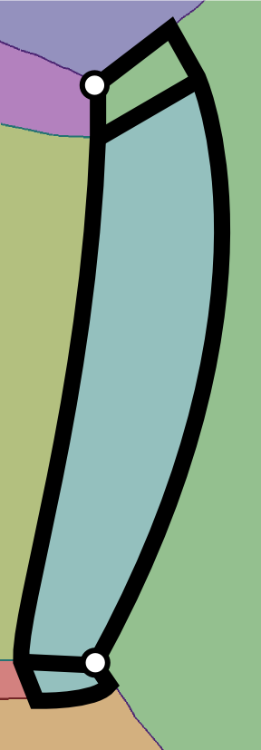
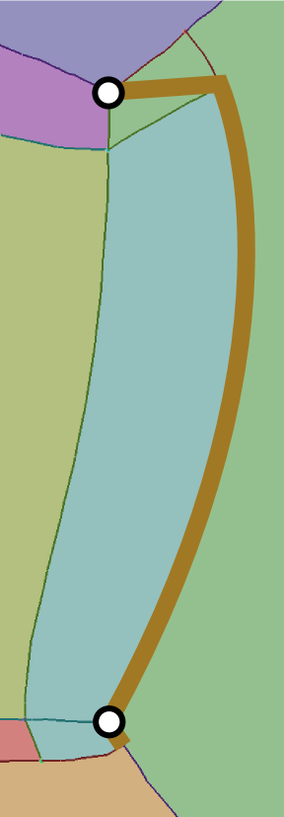
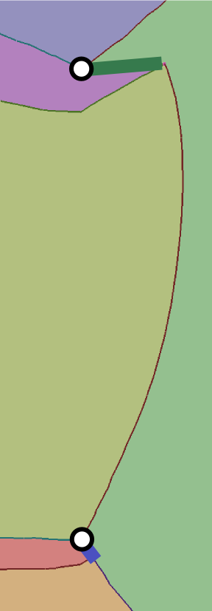
Strategy 2: T-mesh simplification
0-chain collapse
0 lengths
extend to form 0-chain
collapse chain to curve

Slide 19
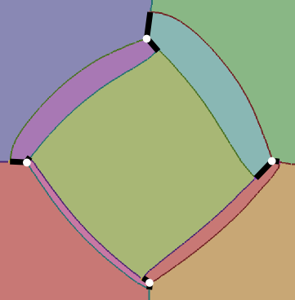
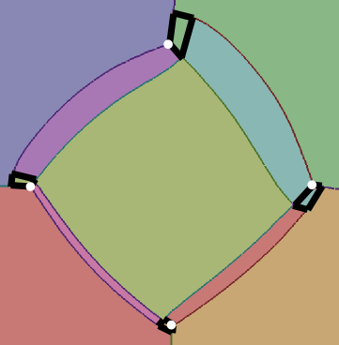
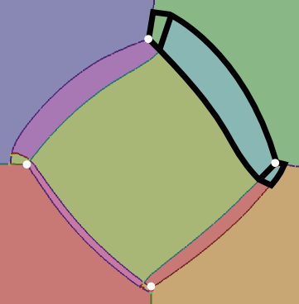
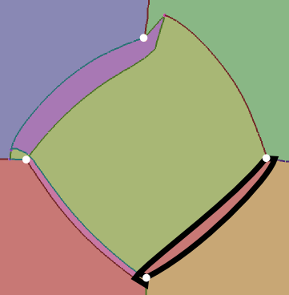
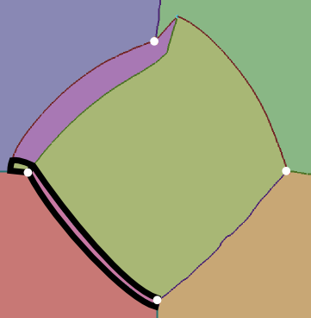
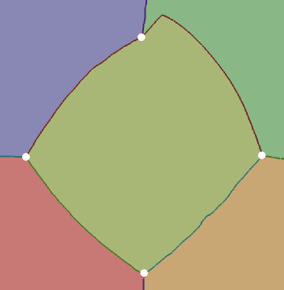
Strategy 2: T-mesh simplification
Iteratively collapse 0-chains.

Slide 20
Conditions for success
Succeeds if the topology of the field permits a quadrangulation, except:
Informally
No valence < 3 singularities on 0-chain
Singularities of valence 3 not collapsed together
No loop completely collapsed (parametric length of loop 0)
Fall back on 2-6 singularity insertion for remaining 0-chains.

Slide 21
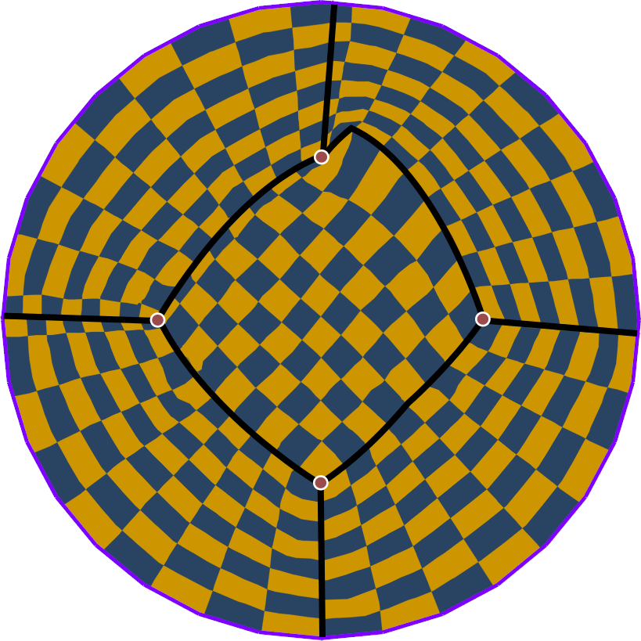
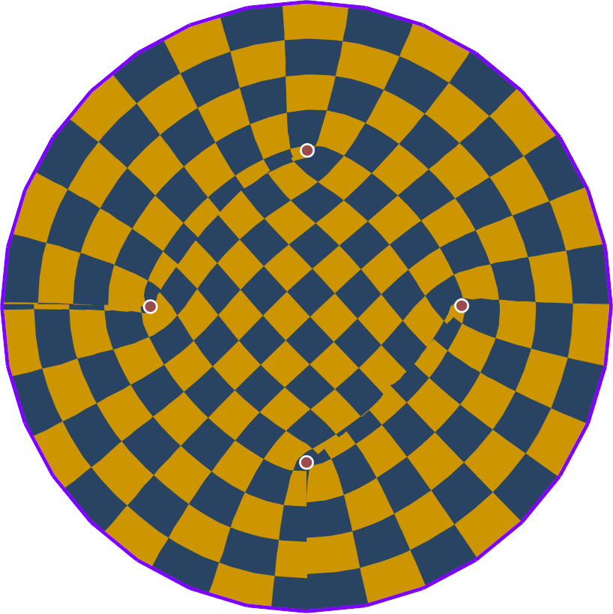
Initial parametrization + optimized
Convex bijectivity constraints [Lipman 2012]
Initial parametrization
Optimized parametrization

Slide 22
Bijectively parametrized 114 meshes
Test data set
All manifold triangle mesh models from the AIM@Shape database.
Few models from the Stanford shape repository.
Commonly used ones.
Down-sampled to 100K triangles
Initial parametrization is fast.
Optimized parametrization with convex constraints is slow (non-linear).

Slide 23
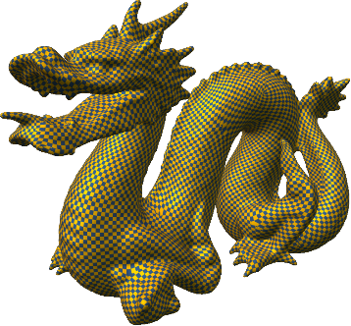
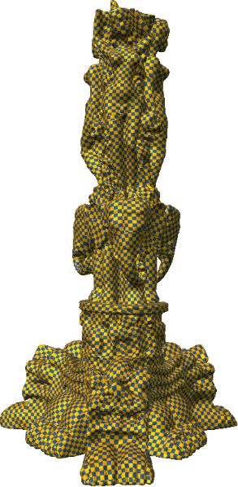
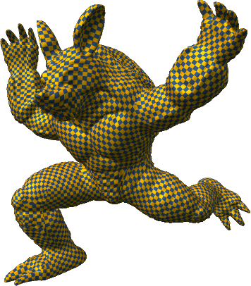
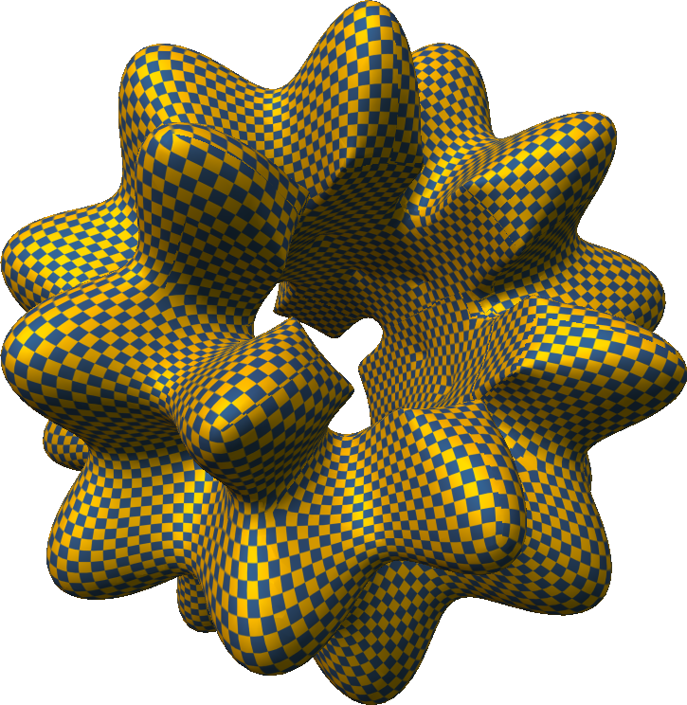
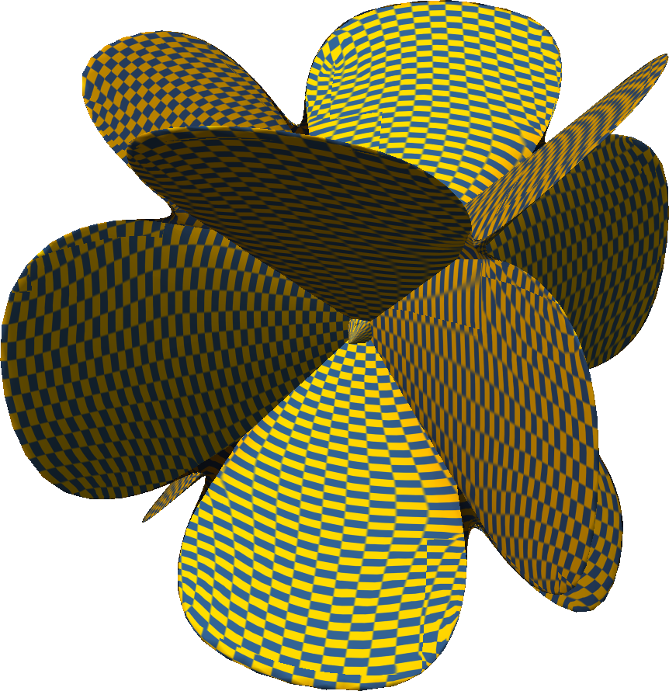
Challenging geometry

Slide 24
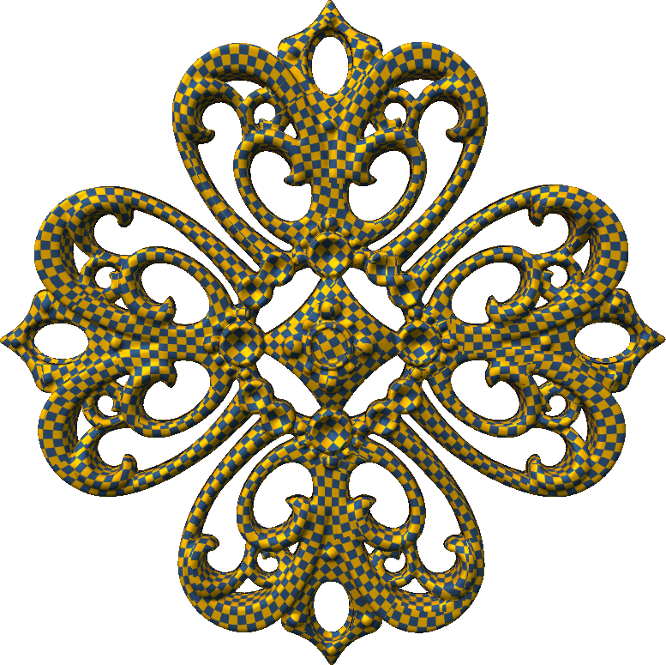
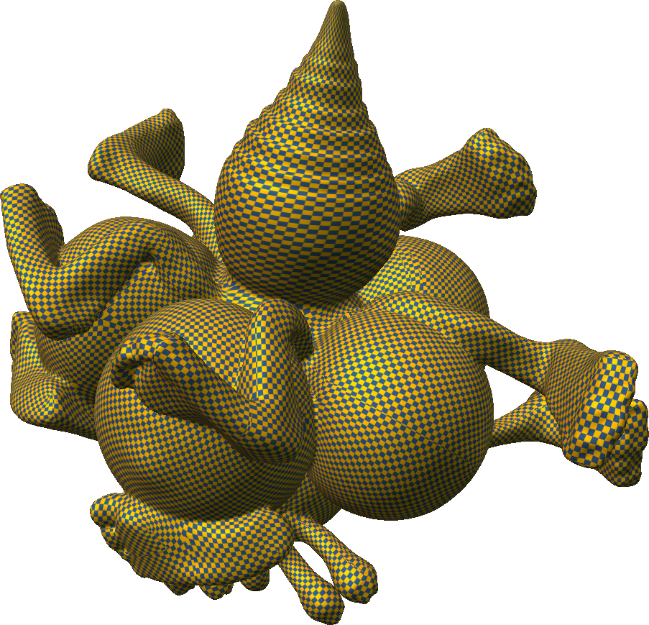
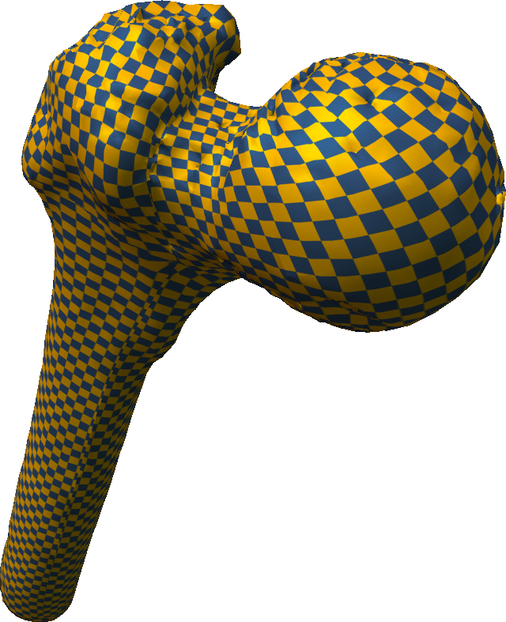
Models with topological noise
Digital capture or free-form modeling
Genus 2
Genus 65
Genus 5

Slide 25
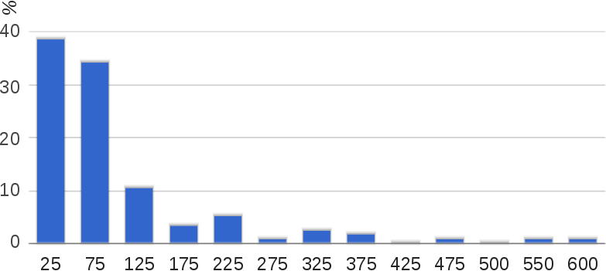
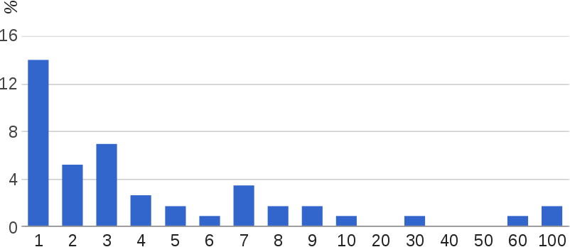
Data set statistics
Singularities
Genus

Slide 26
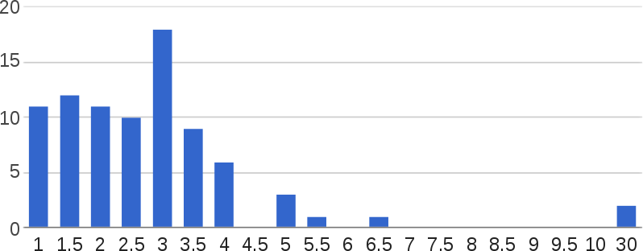
Timings
Tracing, collapse, cone insertion
Seconds

Slide 27
How you compute the field matters!
Smooth cross-field
Conformal cross-field
Computed via [Bommes 2009 – MIQ]
T-mesh simplification: 39 models
2-6 singularity insertion: 4 models
Computed via [Myles, Zorin 2012], [Myles, Zorin 2013]
T-mesh simplification: 6 models
2-6 singularity insertion: not needed

Slide 28
Thank you
Surface with feature-aligned cross-field
Feature-aligned quad patches after simplification
Initial (robust) parametrization
Optimized constrained parametrization [Lipman 2012]

Slide 29
Backup slides

Slide 30
Seamlessness vs Quadrangulation
No constraint across cut
Seamless (independent of grid resolution)
Quadrangulation
[Bommes et al 2013] Integer-Grid Maps
Our focus

Slide 31
Impediments to tracing patch layouts
Local traceability: finite number of integral lines through vertices
Elliptic sector
Parabolic sector
Hyperbolic sector
✗
✗
✔

Slide 32
Impediments to tracing patch layouts
Local traceability: parallel integral lines shouldn’t merge (actually follows from previous constraint)
✗
Triangular patch
✔

Slide 33
Impediments to tracing patch layouts
Global traceability
Limit cycle

Slide 34
Motorcycle graph
Can prove
Patches are either quads or cylinders.
Cylinders practically impossible except when forced by feature curves.
Cylinders can usually be cut by tracing an integral line.
Doesn’t always work!

Slide 35
Cylinder with limit cycle
Rotates by 90 degrees
Did not encounter this case in test models. But modified algorithm in the paper.

Slide 36
Infeasible cross-field topology
Forced 0 lengths
Simplified layout
Initial parametrization
Optimized parametrization

Slide 37
Infeasible cross-field topology
Forced 0 lengths
Field rotation 90 degrees
2-6 singularity pair added
Optimized bijective parametrization

Slide 38
Infeasible cross-field topology
Forced 0 lengths
2-6 singularity pair added

Slide 39
Room for improvement
Distance between 2-6 pairs.
Why not quadrangulation? Requires integer lengths.
Numerical precision
Seamless
Quadrangulation

